Slide 1
Our delighted customers
"The redesign looks great and I really value your efforts; you have nailed what I was looking for. My experience with the TSL Team is perfect, as always!"
-Tom Seadler, President - CEBOS
"Everyone did an amazing job and made everything look flawless when I know there was a ton of activities going on behind the scenes. Very professionally done and managed. I am looking forward to an exciting official launch next week where we can tell the world about the new Fairbanks Morse!!! Awesome job!"
-Kimberly Getgen , VP Sales & Marketing – FM
"TSL nailed it! We have had a great experience working with you from the beginning and you continue to impress us every time we meet. Our new website is a transformation and we can finally be proud to show it off! Thank you for everything."
-Craig Lis , Marketing & Communications Director – Carrier Logistics
"Let it roll! You will continue to hear 'yes' from me because I have such a high degree of confidence in TSL and in the ideas and recommendations coming from your team. Your team continues to prove their expertise to me on every single call."
-Michael Sedlmayer, President & Chief Architect, Re-Store, LLC
RECOGNIZED, KNOWN, TRUSTED

Slide 2
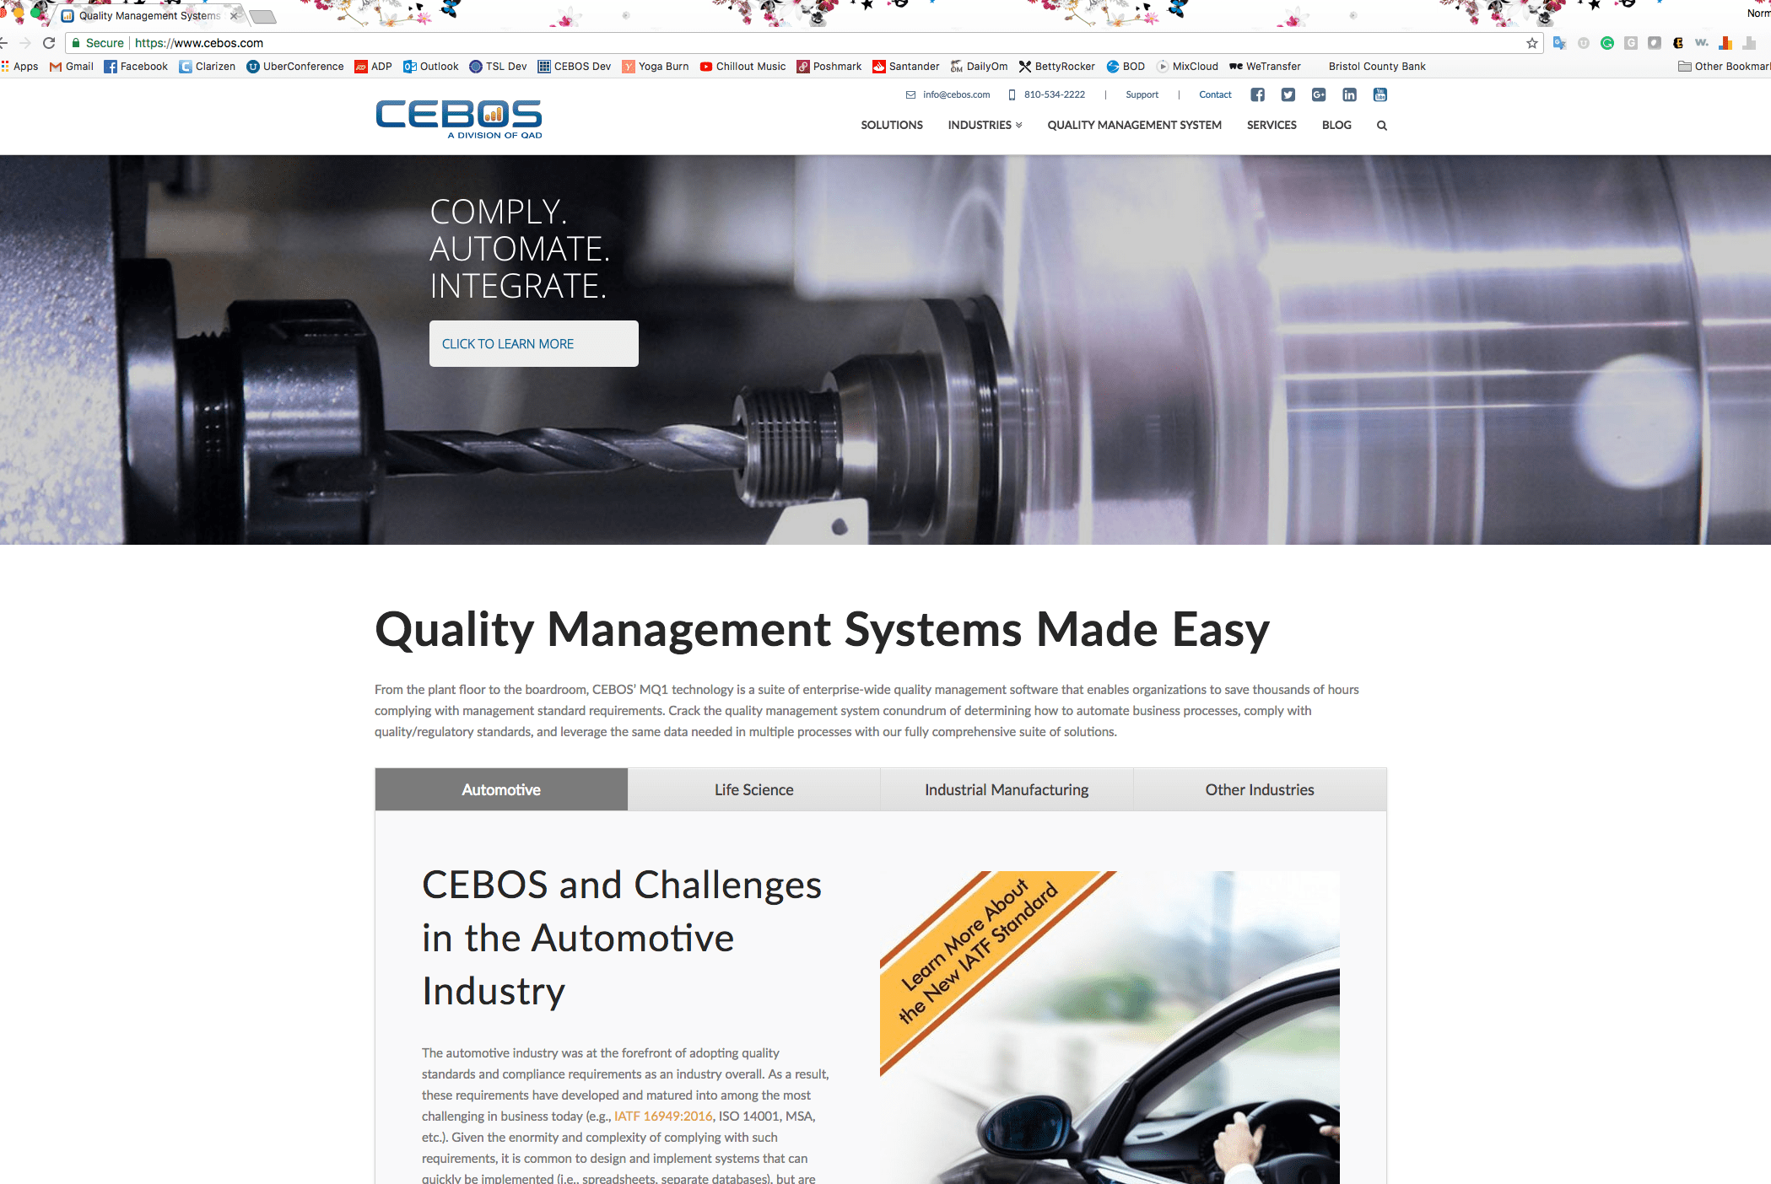
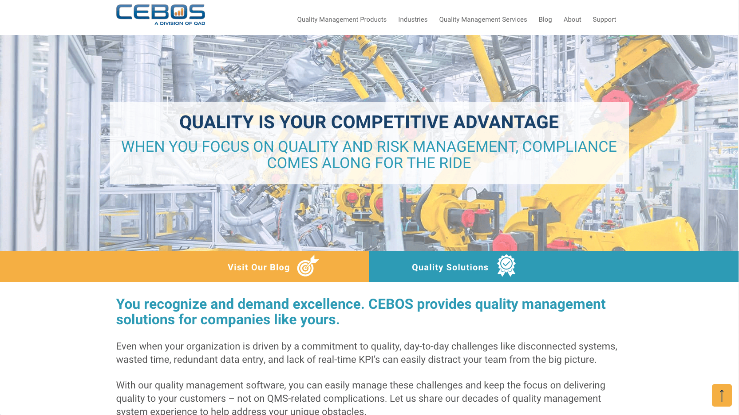
CEBOS

Slide 3
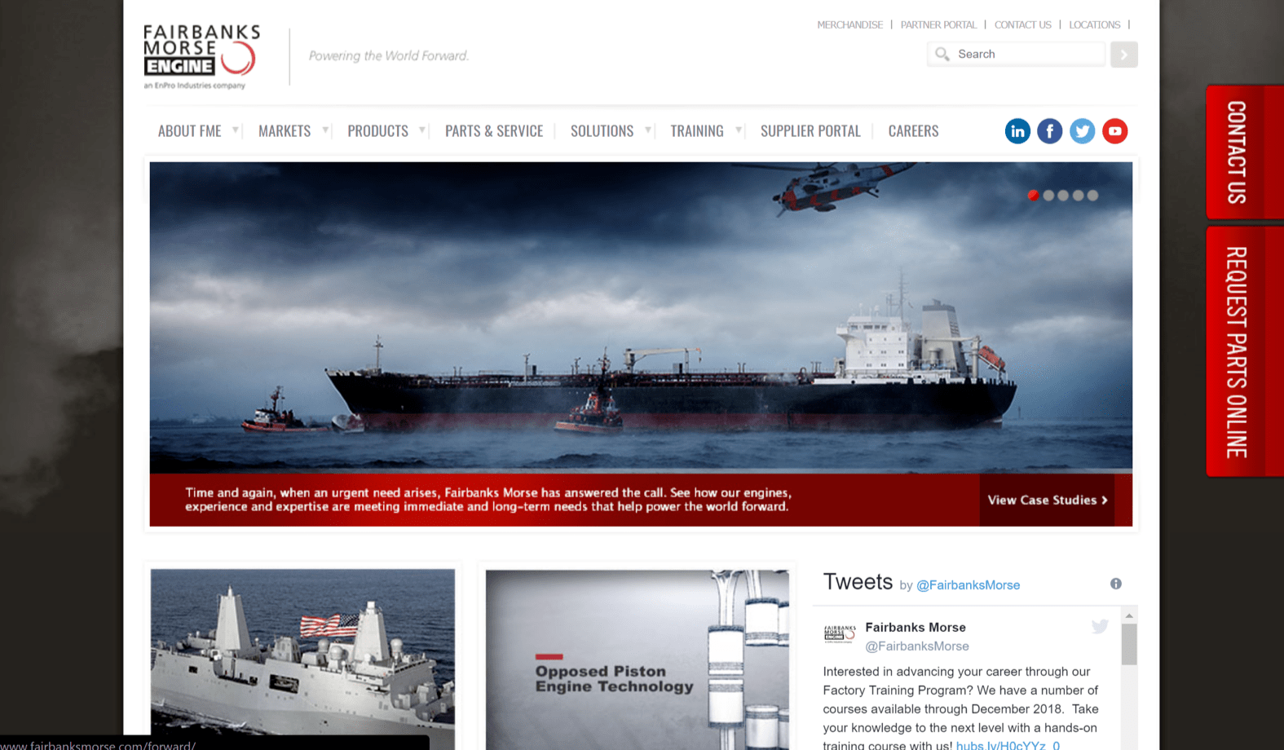
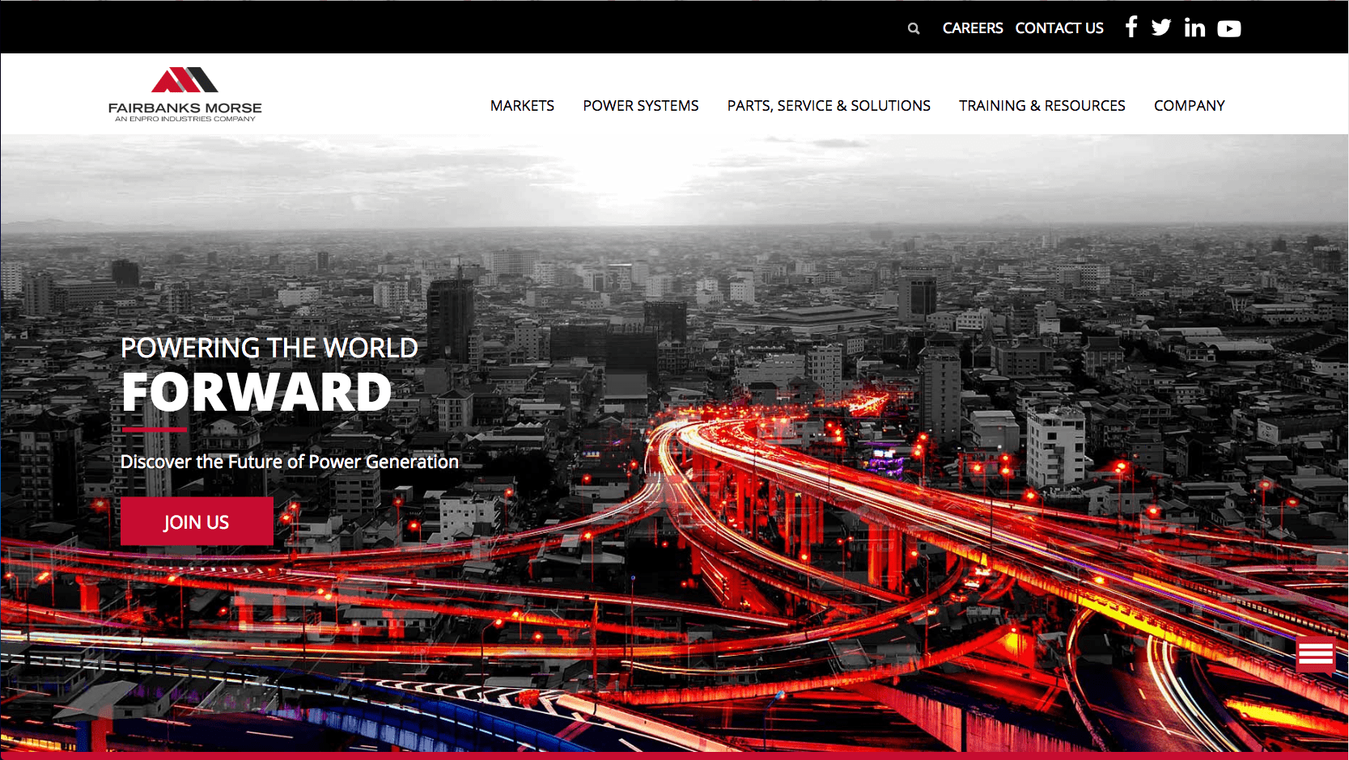
Fairbanks morse

Slide 4
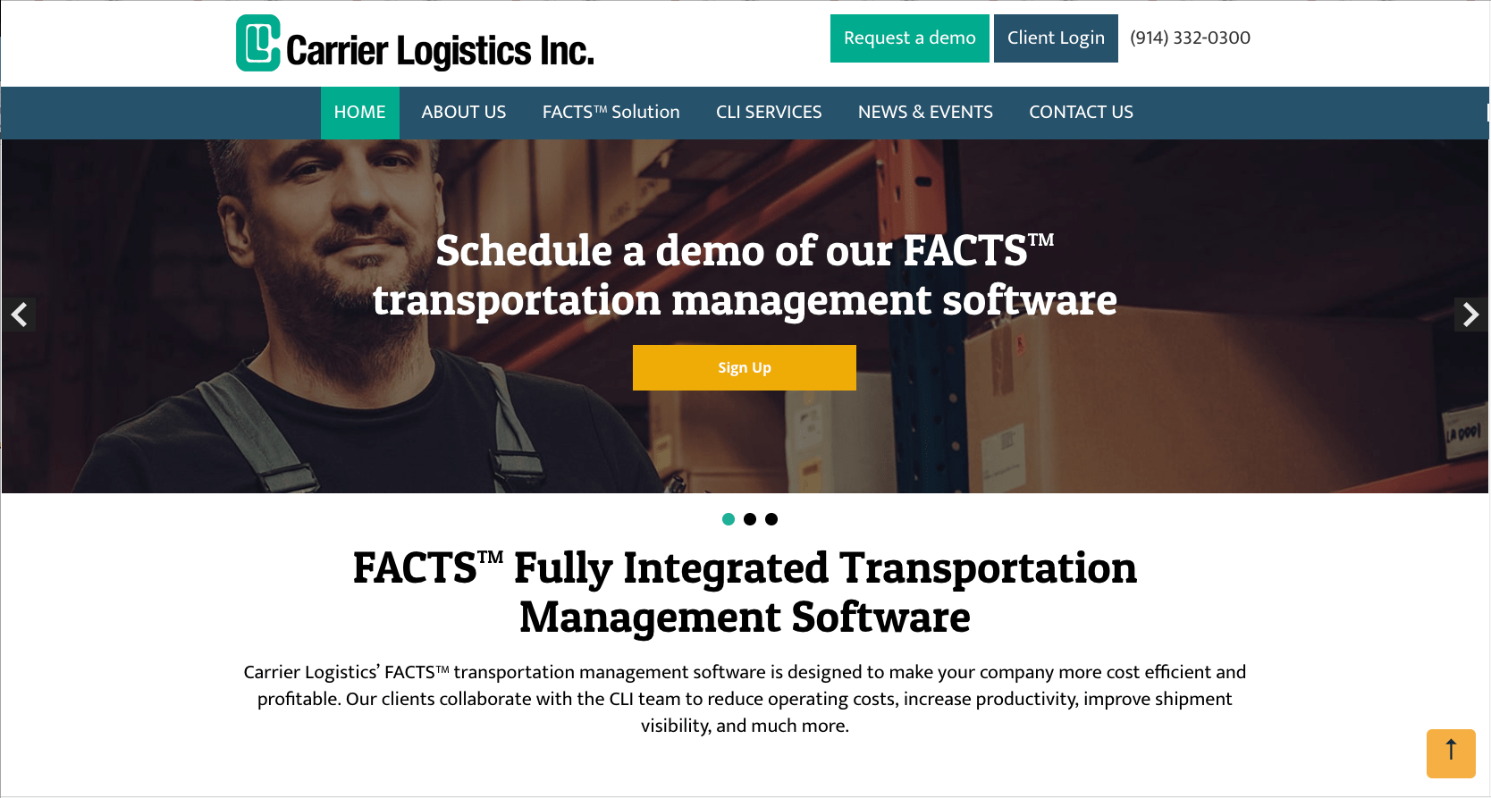
Carrier logistics

Slide 5
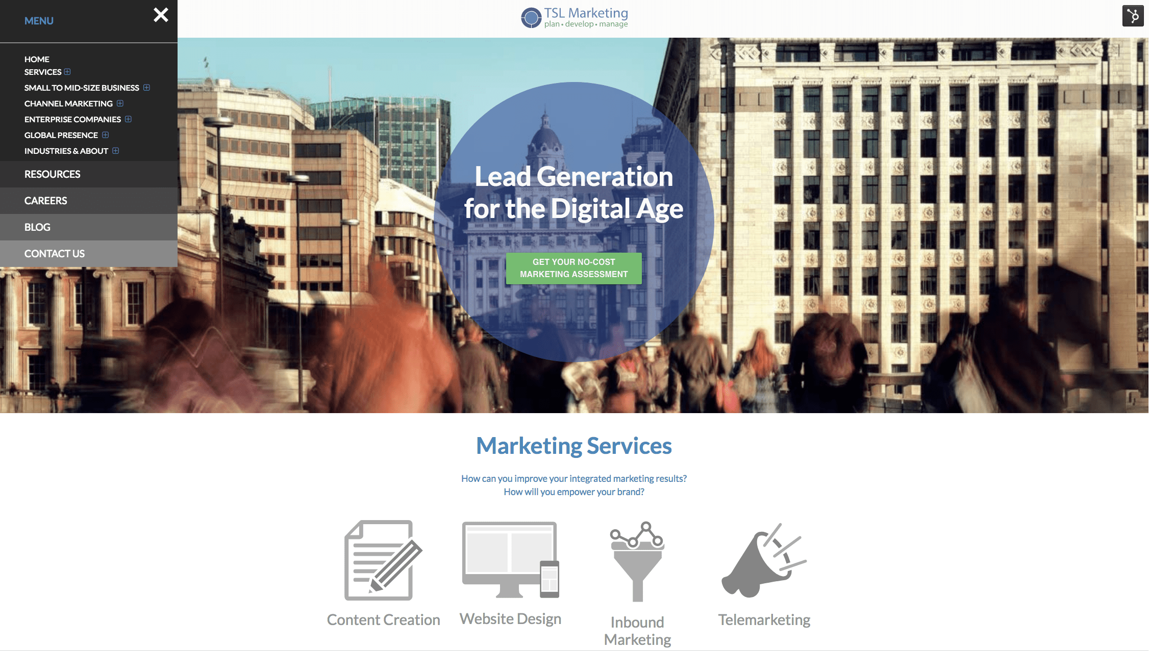
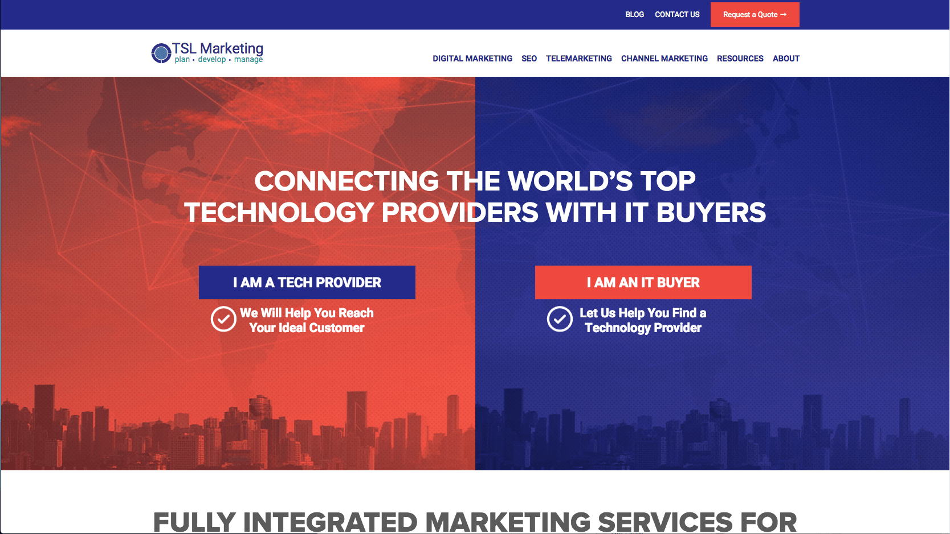
tsl marketing

