Slide 1
Communication hub
kickoff
https://www.iswhub.com/

Slide 2
Website kickoff call agenda
Introductions
Introduce TSL Team
Introduce Initium SoftWorks project stakeholders
SOW Review
Road to Communication Hub: What’s Next?
Communication Hub Process Overview
Phase 1 Strategy Planning
Critical Project Milestones & Scheduling
HubSpot vs. WordPress
Website Goals Overview
Define Goals & Next Steps

Slide 3
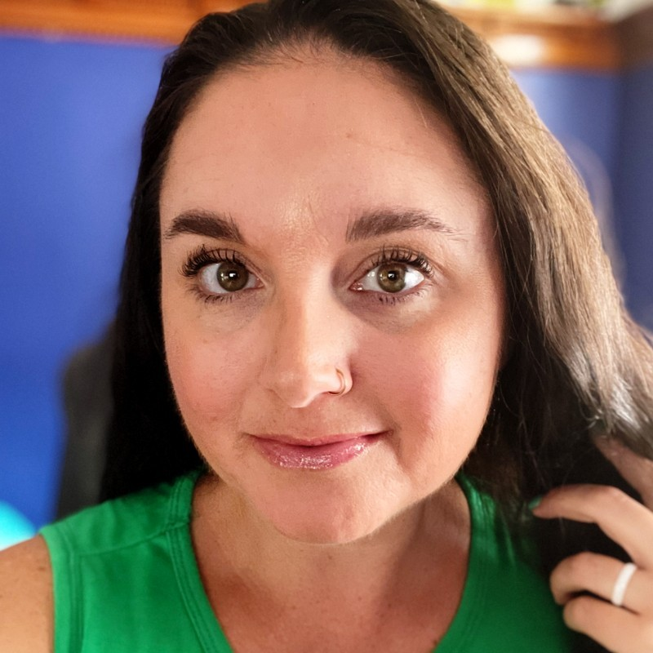
your TSL WEBSITE STRATEGY team
Wesley Beggs
Project Management
David English
Growth Team Rep
Ryan Brady
SEO Strategy
Norma Shepardson
Website Strategy
Anthony Goddard
Website Development
Jamie Hill
Website Design
Michele Balze
Website Copy
Jenni Schreiber
Editor

Slide 4
communication hub stakeholders
Stakeholder Name | Title | Role / Responsibilities
Examples of roles or responsibilities may include:
Stakeholder / Project Owner
Subject Matter Expert (Which area or subject specifically?)
Approval

Slide 5
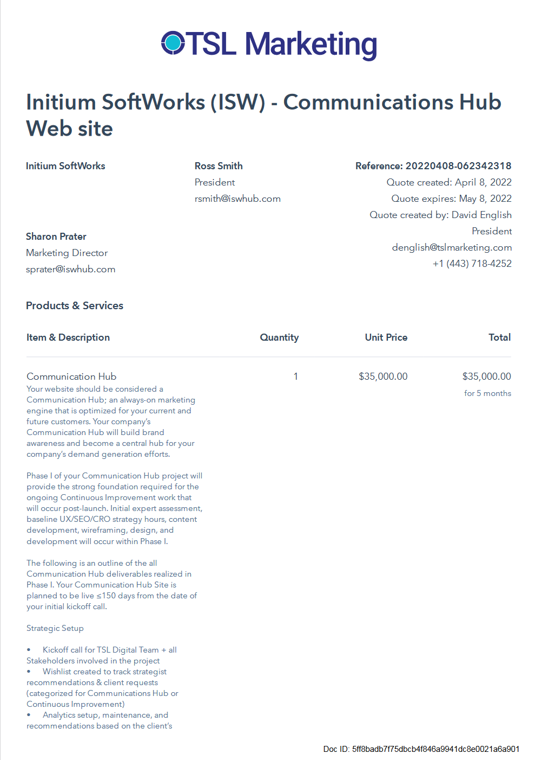
SOW Review
Walkthrough of signed website SOW to confirm project details.

Slide 6
The road to COMMUNICATION HUB:
What’s next?

Slide 7
PHASE I: what is a launchpad?
Your Launch Pad website is launched quickly and serves as
the foundation for future optimization.
The goal of the Launch Pad website is to quickly build a website that looks and performs better than what you have today,
but is not your final product. Your Launch Pad is the foundation from which you collect real-user date and optimize.
Your Launch Pad website project will focus the majority of time & budget on the pages that can drive the greatest impact (homepage + top level nav + landing page(s)).
Your Launch Pad website is not your final product. Instead of focusing on perfection for launch, the focus is shifted to usability & searchability (user & data focused).
Your Launch Pad site map will be built so that users are able to ‘find’ these pages, and then we will put a ‘fresh coat of paint’ on the remainder of the site for launch day.
Your Launch Pad will fast-track to go live! To accomplish this, we focus on creating new content only for pages that are identified as having the most impact out of the gates.

Slide 8
Communication hub project milestones
On the following slide is a timeline showing our Phase I ‘tollgate’ milestones.
All project stakeholders that are identified as critical on our KOC are required on milestone checkpoint calls.
TSL requires full and complete stakeholder approval on each milestone before proceeding to the next step.
Why are all project stakeholders required on so many calls?
The timeline is built to keep each other accountable. We will review it up front to ensure the proposed schedule is manageable for the entire team. Now is the best time to share insights into scheduling challenges, including planned vacation/holiday time, times when your business may be overly busy or unavailable (hosting an event, for example), etc.
Requests for revisions after approvals have been given will result in a change request form and possibly additional investments. Revisions after a milestone has been approved also creates delays in the project which will impact our proposed go-live committed date.

Slide 9
Communication hub project milestones
Website Development & Migration
8/15-8/31
Website Copy & Interior Page Wireframes
8/1-8/12
Homepage Design & Copy
7/18-7/29
Homepage Wireframe & Style Board
6/27-7/15
Month 1
Sep
Month 2
Oct
Month 3
Nov
Finalization & Approval of Site Map & Plan
6/13-6/24
Site Map & SEO Baseline
5/31-6/10
Month 4
Dec
Month 5
Jan
Month 6
Feb
Brand Intake, Offers, Goals
5/31-6/3
KOC
5/27
Month 7
Mar
Month 8
Apr
Q1
STRATEGY & GOAL SETTING
LAUNCHPAD COPY, DESIGN, & DEVELOPMENT
CONTINUOUS IMPROVEMENT
*Dates Are Approximate Based on Project Plan
Notes:
KOC & Goals
Kickoff project with TSL Team & business stakeholders. Discuss business/website goals & objectives.
Brand Intake
Brand & UX conversation with website/marketing stakeholders to establish brand guidelines for website. Will be used to develop style board.
Offers & Content
Intake call with business stakeholders to establish website primary & secondary offers, discuss content strategy.
Site Map & SEO Audit
Review optimized site map / site structure for launchpad website and discuss current website performance.
Homepage Wireframe
Stakeholder review of homepage wireframe to confirm that we are approved to move into design.
Homepage Design
Stakeholder review of homepage design to confirm we are approved to move into copywriting / interior page wireframe builds.
Development & Go Live
Site will be developed in our test environment. Stakeholders will review test site and approve for migration.
Continuous Improvement
Harvest phase begins immediately following launchpad migration. Longer term, strategic site monitoring, testing and updates will continue through the end of August.

Slide 10
CONTINUOUS IMPROVEMENT
HARVEST PHASE
USABILITY
CONVERSION RATE OPTIMIZATION (CRO)
SEARCH ENGINE OPTIMIZATION (SEO)
ASSETS / CONTENT
Action critical fixes & updates post-launch to create the best user experience
Reduce friction & improve UX to ensure visitors find what they are looking for.
Evaluate existing / add new CTA’s and funnels to the site to increase conversions.
Ongoing SEO strategy work will seek to increase traffic month over month.
Refresh / create content that will help visitors convert.

Slide 11
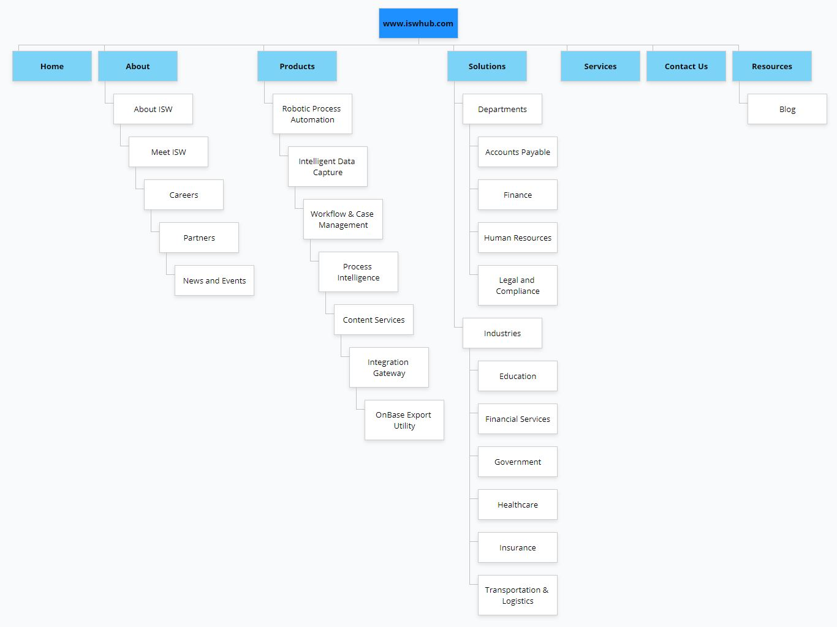
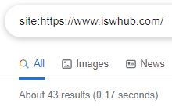
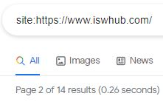
EXISTING SITE MAP REVIEW
Homework: Review existing sitemap and identify pages to KEEP as we move into Launchpad
Crawl: Completed full site - can be used to review pages/ junk/ do redirects
Sitemap: Visual site map completed; added to slide 15. Also, a full sitemap can be created from the crawl, showing every indexed page/ linked page (gets a bit overwhelming with large sites)
Index Size:79 considered valuable/ not supplemental; 105 currently indexed pages
Website Size: 33598 assets - 33183 that are HTML pages
Notes:
The site is excessively big because they have a ton of junk pages / junk dynamic pages / category pages. We should talk to the client to see if they did any of this with intent or if we can remove most of it. The project risk I see for this is just spending excessive hours looking into all the crawled pages & confirming redirects. Full crawl is complete (used for looking at all pages/ indexed pages/ images/ assets like PDFS, redirects, etc).

Slide 12
Website goals & objectives

Slide 13
WEBSITE KICKOFF CHECKLIST
Website & Analytics Access
Brand Guidelines & Assets (logo files, etc.)
Information About Your Company & Customers
Website & Marketing Goals
SEO Starter Items

Slide 14
WEBSITE ACCESS REQUIREMENTS

Slide 15
WEBSITE ACCESS REQUIREMENTS
FOCUS AREA | CUSTOMER ACTION ITEM
Google Analytics Access | Add analyticsinbound@gmail.com to your Google Analytics account See this article for instructions
Current Web Platform | WordPress or HubSpot? Is the plan to stay with your current platform?
Website Access | WordPress: Admin User Level HubSpot: Super Admin
TSL Dev Team Emails | rbrady@tslmarketing.com kstarkey@tslmarketing.com nshepardson@tslmarketing.com
Websites/Sub-Domains | Provide a full list of all active websites, including subdomains, 3rd party solutions (think career pages, support portals)
IT Contact | Who is our contact for technical questions?
Current Web Host & Environment | Siteground, Rackspace, Bluehost, GoDaddy, etc. Are there specific plugins being used heavily by your team? How are forms setup on your site today? Any additional analytics or tracking applications in use? Any custom functionality existing on the site today?
Backups & Security | Do you have daily/weekly website backups? Do you have a website security monitoring solution in place?

Slide 16
BRAND CHECKLIST
Brand Guidelines / Style Sheet
Do you have established brand guidelines?
EPS Logo
Do you have an eps or ai version of your logo available?
Fonts
What fonts are approved for your brand and when are they applicable?
Are they Google fonts?
Colors
What are your primary and secondary palettes?
Icons, images, or other brand elements?
Do you have any established sets of icons that your brand uses for website, collateral, etc.?
What is the voice of your brand? What ‘feeling’ do you want users to have when thinking of your company?
What tone or voice do you want your brand to convey?
Ex. Casual, approachable, professional, enterprise, humorous, empathetic, etc.
What do you want your brand to evoke?
Ex. Trust, compassion, quality, welcoming, expertise, experienced, caring, dependable, etc.
Website
Is your website branding up-to-date?
Is your website content up-to-date/relevant for your business today?
Customer Experience
What do you want your users to get right away when visiting your website?
What is the reason your company/brand exists?
Competitive Advantage / Emotional Connection
What are ways that you solve your customer’s problems?
What are issues/challenges making them feel stressed out?
What are ways that you resolve that stress for them?
How is this different from your competition?
Inspiration: What are some websites that you admire? For what reasons?
List of websites
Inspiration: What are some websites you do not like? For what reasons?
List of websites

Slide 17
COMPANY INTAKE & GOAL SETTING
WHY do you want to refresh your site?
Value Prop / Business Objective & Goals
Are you shifting product, solution, or market focus?
What are your growth areas?
Do you have an established business objective / value prop?
Any established business goals?
What are your competitive differentiators?
Who are your competitors?
Personas / Users
WHO are your key personas / target audience?
Website Goals & KPIs
WHAT do you expect your Website to deliver for your business?
The first step in our strategy phase to gain a better understanding of your business, goals, and target audience. The focus areas to the right and on the next slide will be covered, and we will use this information as we move forward into developing your site map.
GOAL: Set your launchpad site up for success by establishing a strong foundation that is focused on your audience.
ACTION: Review these topics and be prepared to share with your TSL digital strategy team. Ensure all critical stakeholders/subject matter experts attend the call to share their insight so we get a full view into your business and make the most of our time together.

Slide 18
COMPANY INTAKE & GOAL SETTING
ABOUT YOUR BUSINESS | DIGGING DEEPER
What is the main function of your business? | What are you known for?
What is your key differentiator? | What makes you stand out?
What are your current products / solutions / services? | Are they represented on your existing website? Which ones are driving your business?
Confirm what your business is being ‘found for’ | Found in SEO Audit (provided by TSL)
Confirm Priority CTA – the ultimate action a user can make | Additional CTAs? Downloads, Events, Newsletter / Blog Subscription
How do your customers currently get in touch with you? | Phone Email Office Hours (In Person) Online: Chat / Web Support / Help Desk

Slide 19
CUSTOMER INFORMATION
What are your current costs per lead acquisition?
What are your current costs per Sales Qualified Lead acquisition?
What are your current costs of getting a lead that goes to a closed deal?
What are your typical progression rates on leads?
What is your current SQL to win ratio?
this can be based on product type
What are the products that will be promoted?
What are their average deal sizes?
Is any of this retainer business?
What are contract lengths?
What is the retention rate after the first contract?
Beyond just revenue, do you have estimates of profit per win or average lifetime net profit?
Do you have MQL or SQL volume goals?
What are these based off of?
What are your goals for won business or partner won business generated by marketing/advertising?
Which landing pages on your site have the most perceived value in terms of buying intent?
Which have the least?

Slide 20
SEO STARTER info
What do you want your company to be found for?
Are there keywords/search terms you believe you are currently being found for?
What are some questions that users may type into Google as they search for answers to their challenges?
Provide a list of your top competitors and their URLs.
Feel free to categorize them if needed.
Competitor 1
Competitor 2
Competitor 3
Keyword
Keyword
Keyword
What is a question people type into Google?
Why is the Earth round?
Why do cats have tails?
What geos do you currently have customers in?
Where do you want to expand into?
What geos are your focus areas?
Geo 1
Geo 2
Geo 3

Slide 21
Questions? Let’s schedule the call for our next milestone

