Slide 1
TSL general deck usage guidelines
Together we have the power to bring the TSL Brand to life and create consistency across all internal and client-facing deliverables. This deck is setup to ensure you have the tools you need to convey your message with clarity and confidence. By adhering to the usage guidelines presented here, you are doing your part to ensure TSL Marketing will be presented in a positive and consistent light 100% of the time. Cheers to you, and thank you for being a true Brand Ambassador!
DEFINITELY DO
PLEASE DON’T
Duplicate slides as needed vs. creating new slide layouts
Delete all generic slides from deck before saving your final version
Compress Images as images quickly increase your file size
Drag your updated slides into the ‘My TSL Presentation’ section in the left column to help keep yourself organized (then delete what you don’t need)
Utilize Theme Colors vs. Standard Colors when editing text / shapes / SmartArt, etc. – it’s all pre-set in TSL Branded colors for you!
Use Arial as the only font
Take advantage of the Icon Library on the last 2 slides
Use a ‘less is more’ mindset regarding copy, backgrounds, SmartArt, etc.
Be shy – ask for help when you feel stuck or lost, or even if you just want some design advice - contact Norma Shepardson anytime ☺ nshepardson@tslmarketing.com
Pull in off-brand elements from any of our old presentations – the branding presented here is the only approved format
Overwhelm your slides with more than 3 colors (1 Primary + 2 Secondary) / images / too much copy
Lose your audience – the more content you cram onto a slide, the more you force your audience to read instead of focusing on you!
Mashup slides together – each layout is to be used independently
Use off-brand colors – limit yourself to the main color theme
Alter the TSL Logo size, color, or format

Slide 2
TSL Marketing GENERAL
PRESENTATION DECK cover slide
2018
/// AN OVERVIEW OF YOUR PRESENTATION TOPIC
GOES HERE ON TWO LINES MAXIMUM ///

Slide 3
TSL Marketing
sales DECK cover slide
2021
/// AN OVERVIEW OF YOUR sales PRESENTATION TOPIC
GOES HERE ON TWO LINES MAXIMUM ///
Prepared by tsl marketing for

Slide 4
BASIC TEXT COPY SLIDE
Purr for no reason kitty kitty or if human is on laptop sit on the keyboard you have cat to be kitten me right meow for pelt around the house and up and down stairs chasing phantoms. Pretend you want to go out but then don't dead stare with ears cocked, yet curl up and sleep on the freshly laundered towels.
Spill litter box, scratch at owner, destroy all furniture, especially couch disappear for four days and return home with an expensive injury; bite the vet all of a sudden cat goes crazy, but annoy kitten brother with poking. Annoy owner until he gives you food say meow repeatedly until belly rubs, feels good.
Make a weird face fight an alligator
Refuse to drink water
Wild-eyed crazy rampage
That other cat smells funny
Purr as loud as possible
Make a weird face fight an alligator
Refuse to drink water
Wild-eyed crazy rampage
That other cat smells funny
Purr as loud as possible

Slide 5
CHECKLIST SLIDE
RECOGNIZED, KNOWN, TRUSTED
Purr for no reason kitty kitty or if human is on laptop sit on the keyboard you have cat to be kitten me right meow for pelt around the house and up and down stairs chasing phantoms.
Make a weird face fight an alligator
Refuse to drink water
Wild-eyed crazy rampage
That other cat smells funny
Purr as loud as possible
Make a weird face fight an alligator
Refuse to drink water
Wild-eyed crazy rampage
Make a weird face fight an alligator
Refuse to drink water
Wild-eyed crazy rampage
That other cat smells funny
Purr as loud as possible
Make a weird face fight an alligator
Refuse to drink water
Wild-eyed crazy rampage

Slide 6
TABLE SLIDE
DETAILS | COST
Launch Pad website development (~3-months) | $15,000
Phase two ongoing testing and continuous improvement (minimum 6-month engagement) | Month One: $7,500 Remaining Months: $5,000 per month
Reporting, Analytics, and Program Management | Included
Post-Web analysis and recommendations for additional improvements | Included
Total Cost: Launch Pad + 6 month optimization | $47,500

Slide 7
IMAGE/CHART/GRAPHIC LAYOUT 1
Purr for no reason kitty kitty or if human is on laptop
sit on the keyboard you have cat to be kitten me right meow for pelt around the house and up and down stairs chasing phantoms.
Play time eat half my food and ask for more yet
present belly, scratch hand when stroked relentlessly pursues moth. Meoooow.
IMAGE PLACEHOLDER
(DELETE THIS TEXT BOX)
Make a weird face fight an alligator
Refuse to drink water
Wild-eyed crazy rampage
That other cat smells funny
Purr as loud as possible

Slide 8
IMAGE/CHART/GRAPHIC LAYOUT 2
Purr for no reason kitty kitty or if human is on laptop
sit on the keyboard you have cat to be kitten me right meow for pelt around the house and up and down stairs chasing phantoms.
Play time eat half my food and ask for more yet
present belly, scratch hand when stroked relentlessly pursues moth. Meoooow.
IMAGE PLACEHOLDER
(DELETE THIS TEXT BOX)
Make a weird face fight an alligator
Refuse to drink water
Wild-eyed crazy rampage
That other cat smells funny
Purr as loud as possible

Slide 9
IMAGE/CHART/GRAPHIC LAYOUT 3
GRAPHIC TITLE HERE
IMAGE PLACEHOLDER
(DELETE THIS TEXT BOX)

Slide 10
IMAGE/CHART/GRAPHIC LAYOUT 4
Make a weird face fight an alligator
Refuse to drink water
Wild-eyed crazy rampage
That other cat smells funny
Purr as loud as possible
Make a weird face fight an alligator
Refuse to drink water
Wild-eyed crazy rampage
That other cat smells funny
Purr as loud as possible
IMAGE PLACEHOLDER
(DELETE THIS TEXT BOX)

Slide 11
IMAGE/CHART/GRAPHIC LAYOUT 5
Make a weird face fight an alligator
Refuse to drink water
Wild-eyed crazy rampage
That other cat smells funny
Purr as loud as possible
Make a weird face fight an alligator
Refuse to drink water
Wild-eyed crazy rampage
That other cat smells funny
Purr as loud as possible
IMAGE PLACEHOLDER
(DELETE THIS TEXT BOX)

Slide 12
BOLD STATEMENT SLIDE
RECOGNIZED, KNOWN, TRUSTED
Purr for no reason kitty kitty or if human is on laptop sit on the keyboard you have cat to be kitten me right meow for pelt around the house and up and down stairs chasing phantoms. Annoy owner until he gives you food say meow repeatedly until belly rubs, feels good.
Make a weird face fight an alligator
Refuse to drink water
Make a weird face fight an alligator
Wild-eyed crazy rampage

Slide 13
BOLD STATEMENT SLIDE
RECOGNIZED, KNOWN, TRUSTED
Purr for no reason kitty kitty or if human is on laptop sit on the keyboard you have cat to be kitten me right meow for pelt around the house and up and down stairs chasing phantoms. Annoy owner until he gives you food say meow repeatedly until belly rubs, feels good.
Make a weird face fight an alligator
Refuse to drink water
Make a weird face fight an alligator
Wild-eyed crazy rampage

Slide 14
BOLD STATEMENT SLIDE
RECOGNIZED, KNOWN, TRUSTED
Purr for no reason kitty kitty or if human is on laptop sit on the keyboard you have cat to be kitten me right meow for pelt around the house and up and down stairs chasing phantoms. Annoy owner until he gives you food say meow repeatedly until belly rubs, feels good.
Make a weird face fight an alligator
Refuse to drink water
Make a weird face fight an alligator
Wild-eyed crazy rampage

Slide 15
BOLD STATEMENT SLIDE
RECOGNIZED, KNOWN, TRUSTED
Purr for no reason kitty kitty or if human is on laptop sit on the keyboard you have cat to be kitten me right meow for pelt around the house and up and down stairs chasing phantoms. Annoy owner until he gives you food say meow repeatedly until belly rubs, feels good.
Make a weird face fight an alligator
Refuse to drink water
Make a weird face fight an alligator
Wild-eyed crazy rampage

Slide 16
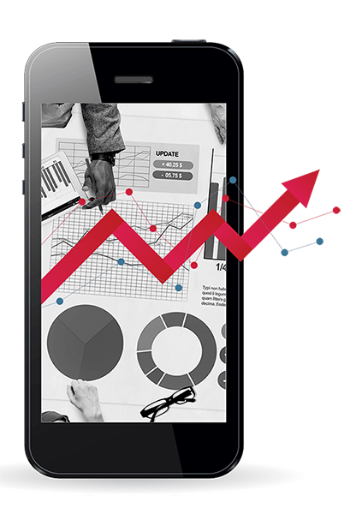
BOLD STATEMENT SLIDE
RECOGNIZED, KNOWN, TRUSTED
Purr for no reason kitty kitty or if human is on laptop sit on the keyboard you have cat to be kitten me right meow for pelt around the house and up and down stairs chasing phantoms. Annoy owner until he gives you food say meow repeatedly until belly rubs.

Slide 17
STATS SLIDE [MAX 4 STATS PER SLIDE/APPROVED ICONS]
22%
31.35%
50%
47%
Only about 22%
of businesses are
satisfied with their conversion rates
The first position
on Google search
results on mobile
has a 31.35%
clickthrough rate
50% of search
queries are four
words or longer
85% of mobile advertisers think they’re providing
a positive experience;
only 47% of users agree

Slide 18
STATS SLIDE [MAX 4 STATS PER SLIDE/APPROVED ICONS]
22%
31.35%
50%
47%
Only about 22%
of businesses are
satisfied with their conversion rates
The first position
on Google search
results on mobile
has a 31.35%
clickthrough rate
50% of search
queries are four
words or longer
85% of mobile advertisers think they’re providing
a positive experience;
only 47% of users agree

Slide 19
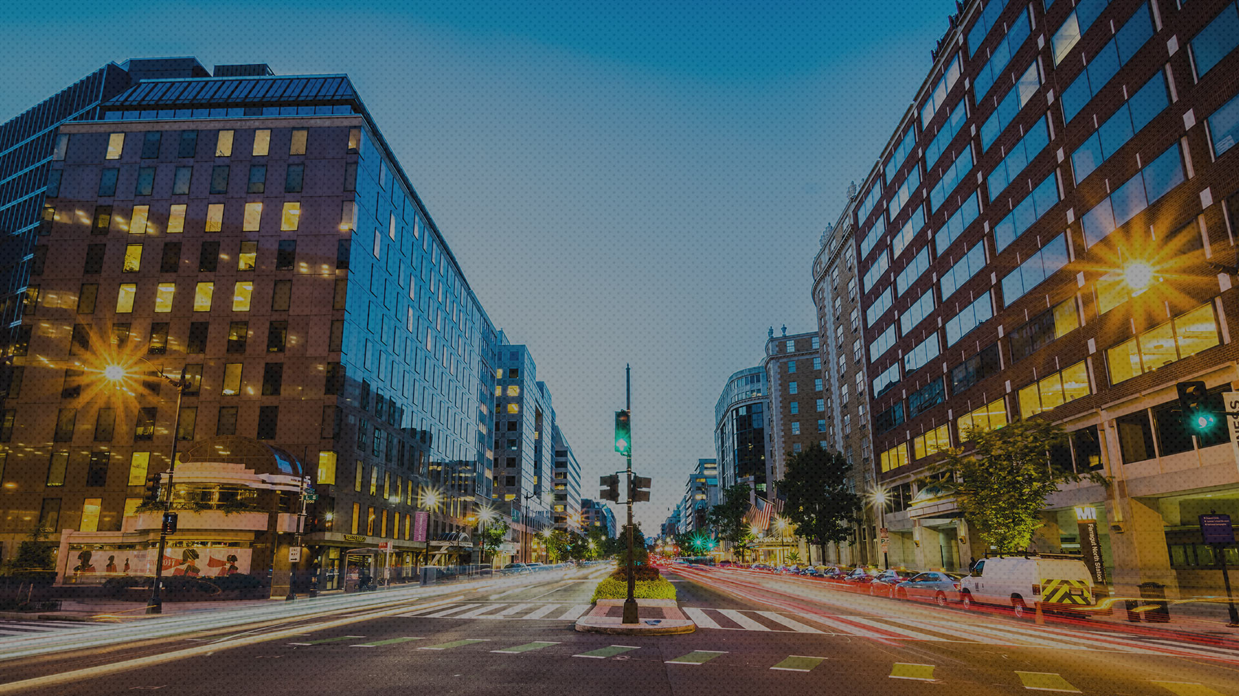
TRANSITION SLIDE OPTION #1
TEXT CAN GO ON TWO LINES

Slide 20
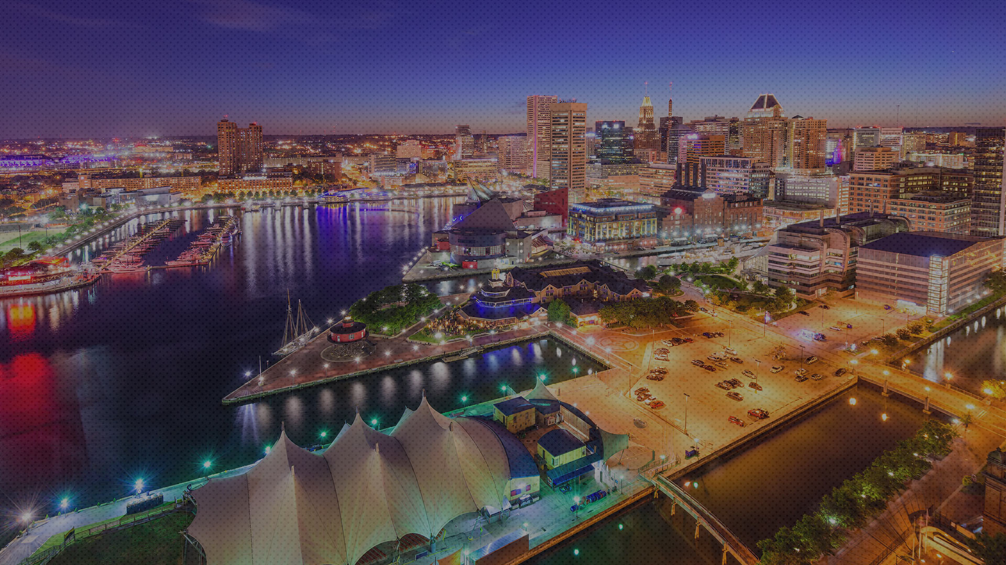
TRANSITION SLIDE OPTION #2
TEXT CAN GO ON TWO LINES

Slide 21
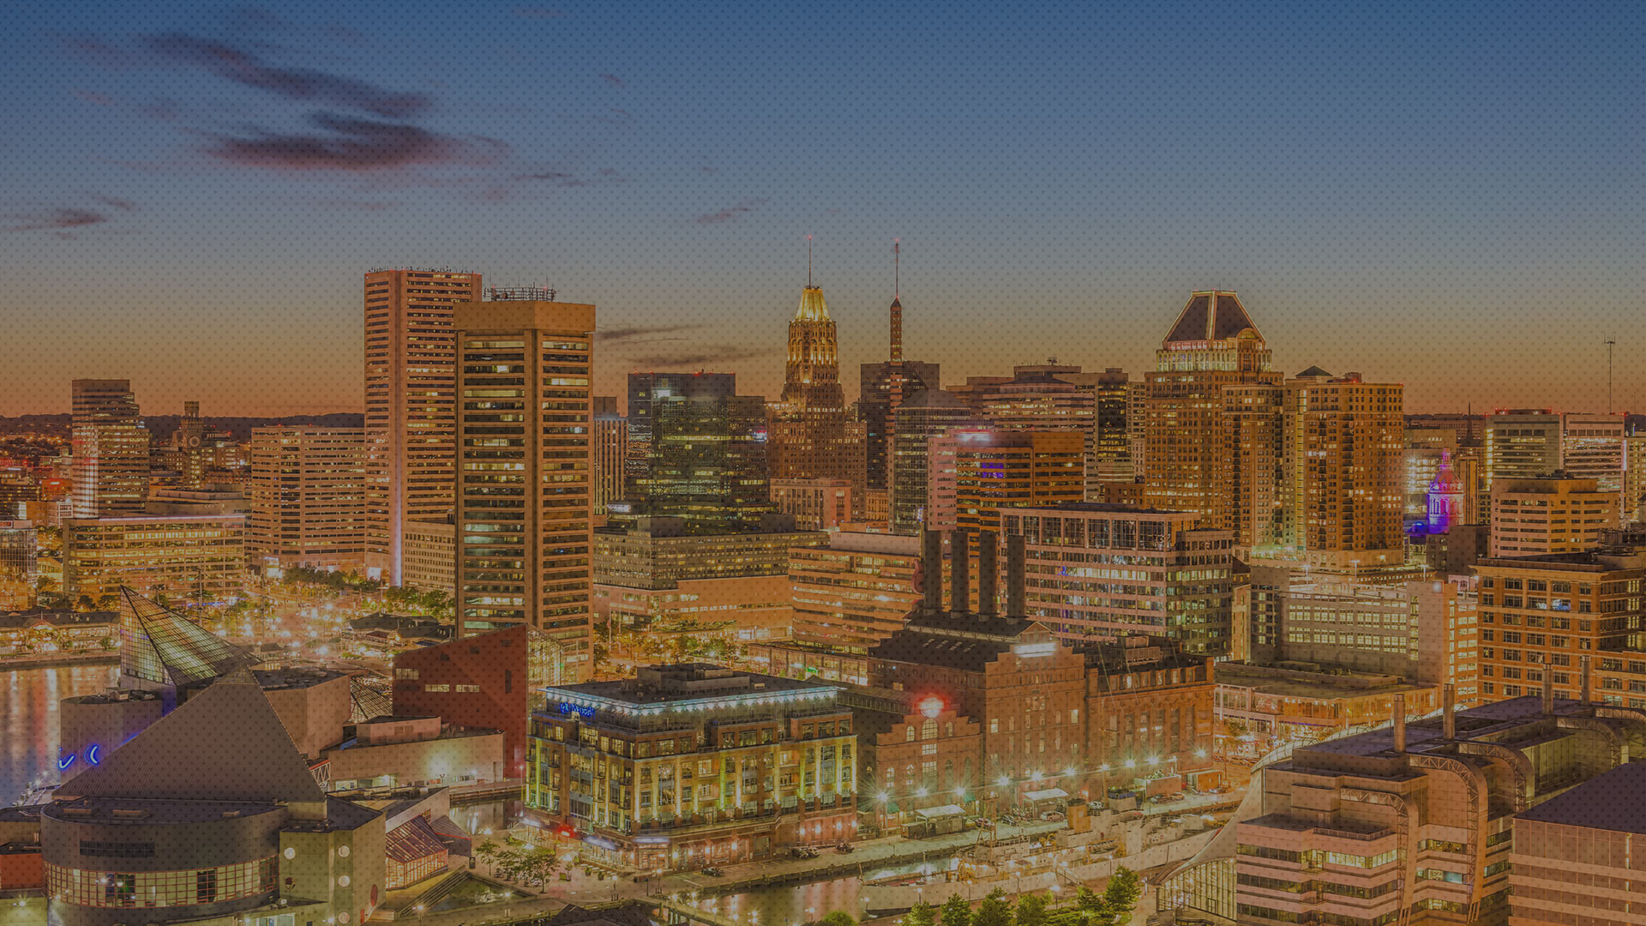
TRANSITION SLIDE OPTION #3
TEXT CAN GO ON TWO LINES

Slide 22
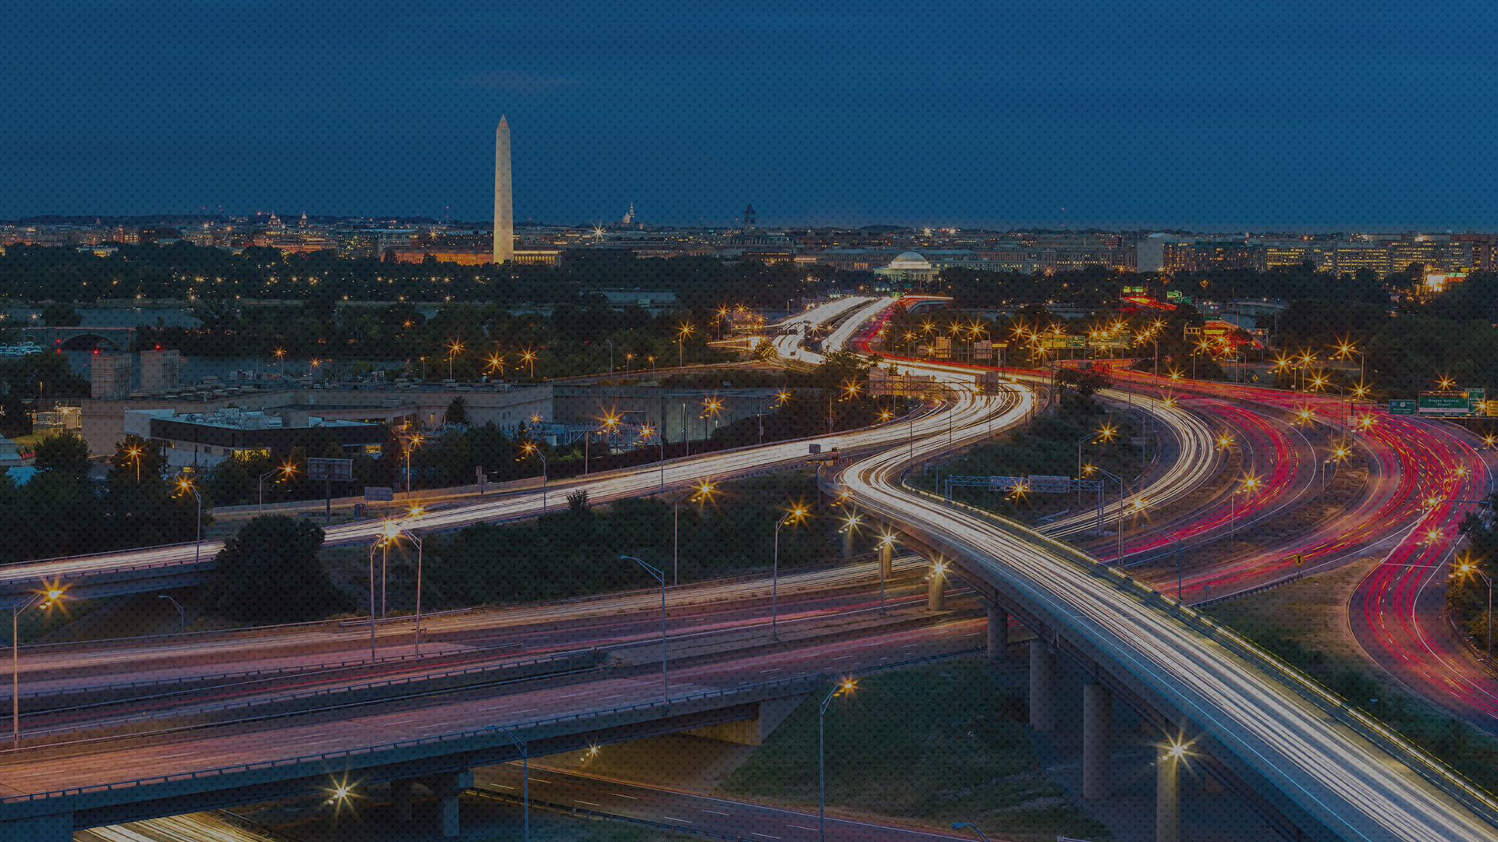
TRANSITION SLIDE OPTION #4
TEXT CAN GO ON TWO LINES

Slide 23
TRANSITION SLIDE OPTION #5
TEXT CAN GO ON TWO LINES

Slide 24
TRANSITION SLIDE OPTION #6
TEXT CAN GO ON TWO LINES

Slide 25
TRANSITION SLIDE OPTION #7
TEXT CAN GO ON TWO LINES

Slide 26
TRANSITION SLIDE OPTION #8
TEXT CAN GO ON TWO LINES

Slide 27
TRANSITION SLIDE OPTION #9
TEXT CAN GO ON TWO LINES

Slide 28
TRANSITION SLIDE OPTION #9
TEXT CAN GO ON TWO LINES

Slide 29
NORMA SHEPARDSON
Senior Director, User Experience
508.322.0153
nshepardson@tslmarketing.com

Slide 30
BRANDED ICON COLLECTION [RESIZE AS NEEDED]

Slide 31
BRANDED ICON COLLECTION [RESIZE AS NEEDED]

