Slide 1
Account Based Marketing
What it is, Why it Matters, & How to Sell It
Notes:
Today we will be talking about our official launch of ABM in hubspot. This is a big day for hubspot, as ABM is a category that more sophisticated companies care deeply about. In the past, we’ve had handwavey ways about selling an ABM strategy in hubspot, moving forward this will actually become a strength of our toolset

Slide 2
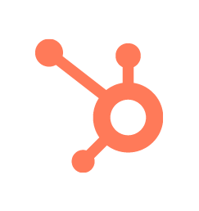
Agenda
What is ABM?
ABM Strategy Overview
HubSpot Value Prop

Slide 3
Key Takeaways
ABM is more of a strategy than a feature or set of tools
We have enhanced Marketing and Sales Hubs to enable ABM within HubSpot
Many of these features are generally useful to customers even if they’re not specifically running ABM strategies (i.e. Account Overview)

Slide 4
What is ABM?
Notes:
In order to learn how to position ABM it will be important to understand the ABM market as a whole

Slide 5
5 Things to Remember about ABM
Laser Focus on Marketing & Sales Alignment
Focus on small subset of Target Accounts, small # of viable buyers
Build ABM on TOP of Inbound
Committee Style Buying
Expensive Product with long buying cycle

Slide 6
B2B can be broadly split into three buckets
We think ABM is best applied here!
Touchless
Low touch
High touch
Notes:
A simple way of thinking about selling strategy is to look break it down on a spectrum of touchless to high touch. Touchless sales is great for products that have a freemium model and you can seed and grow over time. As we approach the low touch model, we find instances where a more traditional sales motion is required to reach out to interested businesses. Finally, you have your heavy sales processes at large, enterprise businesses.
Because, at its foundation, ABM is all about looking at the world through the lens of an account, being really deliberate in choosing those accounts, and being really deliberate in how we engage those accounts. ABM is a strategy well-suited to deals that skew toward high-touch and therefore high-value.
One note, is that businesses can fall in different places on this spectrum. I would argue that HubSpot is an example of a business that uses all of these models depending on the market we’re talking about. HubSpot leverages Inbound for it’s touchless and low touch models and has something that more resembles ABM for it’s high touch model. You customers may be in the same position!

Slide 7
Selling high value deals is hard.
High volume deals |  | High value deals
Low risk to buyer and seller |  | High risk to buyer and seller
Short transactional sales process |  | Long considered sales process
Massive TAM (total addressable market) by number of buyers |  | Tiny TAM by number of buyers
Single buyer |  | Multi-person buying committee
Little to no human interaction |  | Human-intensive, relationship-based
Generalist content |  | Highly personalized content
Marketing hands off to sales |  | Marketing and sales work in lock-step
Avg. of 6.8 people
Notes:
So what actually distinguishes an ABM deal?
The reason companies use an ABM strategy is that high ticket deals are a very different beast than high volume transactional deals. Using HubSpot as an example we take a very different approach when selling MHS to a 5 person company than we do when selling Enterprise Growth Suite to a 200 person company.
There’s a longer buying process, more people involved and more collaboration between sales and marketing throughout the buying process, vs a simple handover from marketing to sales

Slide 8
Companies that benefit from ABM:
 | High value B2B products or services
 | Finite number of target companies
 | Often sell to multi-person buying committee
 | Require personalized content and engagement
Notes:
This slide outlines the ideal company profile for an ABM strategy: They sell high value products or services to a finite market, and engage with multiple stakeholders throughout the process
Think of someone who is a fit is has super high value deals with long sales, so closing 1 deal will be ROI. It also would be something that is a long term strategy
If you are working of someone who has a short cycle, low value deals, it may not be worth ROI to invest the time and effort if they are not a fit (if you dont close that deal for them, it could hurt them and be a waste of money to invest).

Slide 9
ABM: Pros and Cons
Pros of ABM |  | Cons of ABM
Increase personalization of content |  | Increased volume of content needed
Marketing and sales alignment |  | Slow down marketing and sales process
Great understanding of potential customers |  | Narrow pool of target customers
Higher ROI overall |  | Dedicated resources and budget
Higher customer satisfaction |  | Much more research time needed
Notes:
Here are some pros and cons of implementing an ABM strategy. I’m not going to read through all of them, just call out one on each side.
A pro is the marketing and sales alignment you get from an ABM strategy. Traditionally, sales and marketing are not closely aligned with a handoff being the only real interaction, ABM brings these two orgs closer together. This can be time consuming and an adjustment, but normally has great benefit to the org.
A con is definitely the dedicated resources and budget. ABM is a slower process that necessitates the alignment I just mentioned to be successful.
It’s often a lot of work up front, but can be transformative, once it gets cranking.

Slide 10
ABM is more about the thoughtful application of the concepts and strategy then it is about any one toolset.
Notes:
At the end of the day, all customers can use some ABM features or strategies!

Slide 11
ABM Strategy
Notes:
Now that we understand the market a bit more, lets talk about HubSpot’s position

Slide 12
Different Types of ABM
1:1
Marketing works with Sales teams to implement and execute highly customized plans for each account.
MOST RECOGNIZED
HIGHLY Personalization Think personalization FOR EACH COMPANY AND EACH STAKEHOLDER
1:Few
Focus on clusters of accounts that have similar business challenges and objectives.
MOST COMMON
Limited Personalization Think personalization with content to match each stakeholder across industry in buying roles
1: Many
Leverage technology to personalize marketing campaigns for specific, named accounts at scale.
LEAST COMMON* and almost similar to Inbound
Very Limited Personalization Think Smart Content/Personalized Sales Emails (Tokens)
Notes:
Before diving into the specific steps, it’s important to call out that there are several different types of ABM that a company can run. As your customers move forward with ABM, it’s important that they be realistic in choosing one over the other.
1:many is a great fit when you have a limited number of potential buyers, but they are in the thousands (ie: you target IT professionals). It also makes sense when you have a lower ASP. Since there is less personalization required, it can scale much better. This form is the least common in applying ABM as it looks very similar to Inbound.
1:few is the most common as it balances some of the fundamentals of Inbound, with going after some important clusters of accounts. These clusters are usually grouped by industry or another important characteristic of your ideal company (It is personalized on industry but customized on buyer roles - ie: content for each buyer role).
Finally, 1:1 is what most people think when ABM comes up. It’s a highly aligned and orchestrated approach to landing specific accounts that will be of huge value to the company.
Understanding each of these is important as it may change up how we think about the steps involved in implementing an ABM strategy.

Slide 13
So if you determine your client is a fit, below is work to expect

Slide 14
Steps to an ABM Strategy
Step 1: Build an Account Team
Step 2: Identify Target Accounts
Step 3: Build an Account Plan
Step 4: Attract Contacts
Step 5: Engage Contacts and Companies
Build a team of 1 marketer to 1 sales rep
Identify a set list of high value target companies/ accounts
Create a set of goals, content plan, and channel strategy
Leverage personalized content across channels to attract stakeholders
Build relationships and expand within your target accounts
Track and Measure
Measure effectiveness of your strategy
Notes:
Here are the steps involved in an ABM strategy:

Slide 15
Step 1 Build an Account Team
Aligning Marketing and Sales
One marketer to one sales rep or account team
(Never higher than 1:10 ratio of Marketing to Sales)
1:1 Strategy More people involved with each team (I.e. Executives)
1:Many Strategy Other stakeholders involved in creating more general content

Slide 16
Steps to an ABM Strategy
Step 1: Build an Account Team
Step 2: Identify Target Accounts
Step 3: Build an Account Plan
Step 4: Attract Contacts
Step 5: Engage Contacts and Companies
Build a team of 1 marketer to 1 sales rep
Identify a set list of high value target companies/ accounts
Create a set of goals, content plan, and channel strategy
Leverage personalized content across channels to attract stakeholders
Build relationships and expand within your target accounts
Track and Measure
Measure effectiveness of your strategy
Notes:
Here are the steps involved in an ABM strategy:

Slide 17
Step 2
Identify Target Accounts
Demographic
Company size
# of employees
Industry
Locations
Etc.
Behavioral
Benefits needed
Buying cycles
Buying volume
Engagement
Previous sales
Current rep engagement
Number of contacts per deal
Create an Ideal Customer Profile.
The volume of potential Ideal Customer Profile and expected deal size can help determine your ABM approach moving forward.

Slide 18
Step 2 Identify Target Accounts
Which deals are already in progress that could benefit from Marketing materials?
Look at High Value Prospects who are already engaging your site and content
How can we replicate some Sales activities using HubSpot and our tech stack to help accelerate this deal?
Examine recently closed deals and see if you can add value
Pick Target Deals for Acceleration
Pick the top 10-15 deals and run with those target accounts!
Notes:
One of the fastest ways to realize the value of an ABM strategy is to use it to help deals close more quickly. No doubt, the sales team is already expertly educating the buying committee over email, in meetings, and on the phone. But, Sales is limited by how much time each member of the buying committee wants to engage with that rep. What if the decision maker misses a demo meeting or the end-user wants to research on their own time? By deploying marketing (e.g. website smart content, targeted ads, social media, personalized email) that matches the same value propositions (<-- very important) that Sales is using, buyers can make decisions even faster because they are not only being educated by Sales, but they’re also educating themselves!

Slide 19
Step 2 Identify Target Accounts
Is there a segment of the business in which we could be growing faster but are losing deals because buyers don’t recognize our customers or see us as “legitimate” for their needs?
Which brands have the most name recognition and respect among that segment of buyers?
Logo Identification
Pick the top 10-15 companies and run with those target accounts!
Notes:
Of all the reasons to pick target accounts, this one is probably the easiest to understand and implement. The goal of this campaign is to close deals with target accounts whose logos and testimonials would add legitimacy and social proof to your brand.
To get started with a logo acquisition campaign, Sales and Marketing leaders should ask themselves two questions:
Is there a segment of the business in which we could be growing faster but are losing deals because buyers don’t recognize our customers or see us as “legitimate” for their needs?
Which brands have the most name recognition and respect among that segment of buyers?
Having answered those questions, identify 10 - 15 companies that match that criteria, mark them as target accounts,

Slide 20
Steps to an ABM Strategy
Step 1: Build an Account Team
Step 2: Identify Target Accounts
Step 3: Build an Account Plan
Step 4: Attract Contacts
Step 5: Engage Contacts and Companies
Build a team of 1 marketer to 1 sales rep
Identify a set list of high value target companies/ accounts
Create a set of goals, content plan, and channel strategy
Leverage personalized content across channels to attract stakeholders
Build relationships and expand within your target accounts
Track and Measure
Measure effectiveness of your strategy
Notes:
Here are the steps involved in an ABM strategy:

Slide 21
Step 3 Build an Account Plan
Who will be on the buying committee of our target companies?
^^This doesn’t need to be exact names but roles involved^^
What content will we need for each member of the buying committee?
Well, that seems easy...

Slide 22
Step 3 Build an Account Plan
Umm, how am I supposed to do this for every account?!
Business Overview
Key Business Initiatives
Customer Relationship Landscape
Customer Products and Revenue
Account Competitor Analysis
Buying Process and Selling Points
Relationship Goals and Strategy
Sales Opportunities, Targets, and Risks
Action Plan
1:1 ABM - One for every target account
1:Few ABM - One for every target cluster
1:Many ABM - One for every tier

Slide 23
Step 3 Build an Account Plan
https://docs.google.com/document/d/1apraY_SwqPsiuSPis_0XuOMSqwXGkM3Fo4gxMa3M-tw/edit
Who will be on the buying committee of our target companies?
What content will we need for each member of the buying committee?
What do we already have?
Let’s get to work building content...

Slide 24
Step 3 Build an Account Plan
ABM Strategy | Personalize by Buying Role? | Personalize by Company? | Accomplished by...
1:1 | Yes | Fully | Different content for each company and stakeholder.
1:Few | Yes | Limited | Different content for each stakeholder across account cluster
1:Many | Yes | Very Limited | Similar content across ICPs: Using smart content and personalized emails from Sales

Slide 25
Step 3 Build an Account Plan
1:1 ABM
1:Few ABM
1:Many ABM
Notes:
1:1 - FULL personalization. Accomplished by: Different content for each company AND stakeholder
1:Few - Limited Personalization. Accomplished by: Different content for each stakeholder across account cluster
1:Many - VERY Limited Personalization. Accomplished by: Similar content across each “ideal customer profile” using smart content and personalization from sales

Slide 26
Steps to an ABM Strategy
Step 1: Build an Account Team
Step 2: Identify Target Accounts
Step 3: Build an Account Plan
Step 4: Attract Contacts
Step 5: Engage Contacts and Companies
Build a team of 1 marketer to 1 sales rep
Identify a set list of high value target companies/ accounts
Create a set of goals, content plan, and channel strategy
Leverage personalized content across channels to attract stakeholders
Build relationships and expand within your target accounts
Track and Measure
Measure effectiveness of your strategy
Notes:
Here are the steps involved in an ABM strategy:

Slide 27
Attract Contacts
What is the channel strategy for each piece of content?
Hosting events
Industry newsletters or publications
Review sites
Co-marketing with strategic partners
Ads
Sponsored social media
As a high cost strategy, this step is critical to obtaining high ROI!

Slide 28
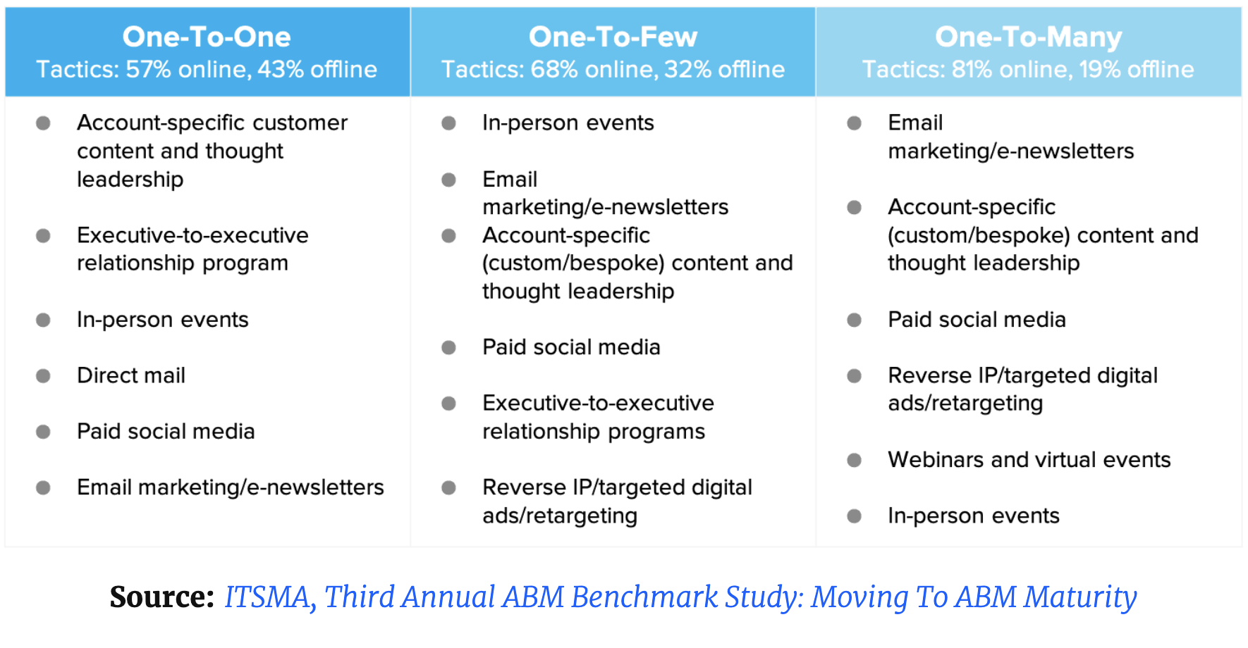
Attract Contacts
As a high cost strategy, this step is critical to obtaining high ROI!

Slide 29
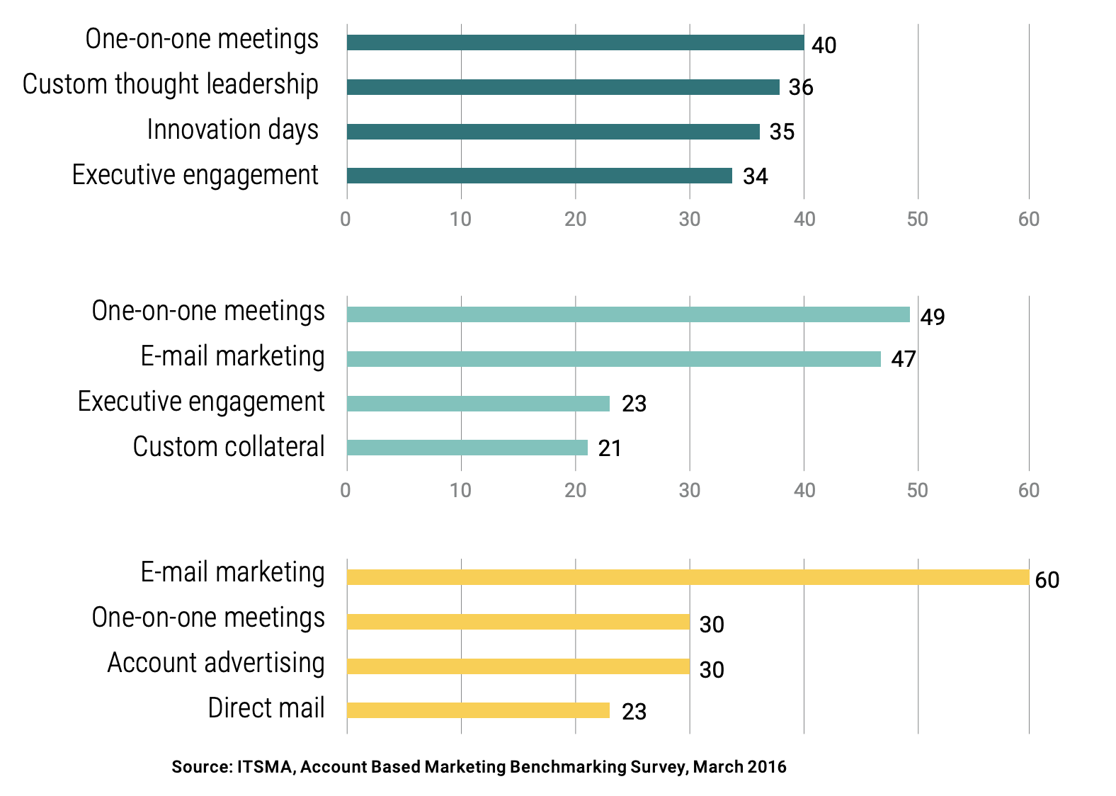
Attract Contacts
1:1 ABM
1:Few ABM
1:Many ABM

Slide 30
Steps to an ABM Strategy
Step 1: Build an Account Team
Step 2: Identify Target Accounts
Step 3: Build an Account Plan
Step 4: Attract Contacts
Step 5: Engage Contacts and Companies
Build a team of 1 marketer to 1 sales rep
Identify a set list of high value target companies/ accounts
Create a set of goals, content plan, and channel strategy
Leverage personalized content across channels to attract stakeholders
Build relationships and expand within your target accounts
Track and Measure
Measure effectiveness of your strategy
Notes:
Here are the steps involved in an ABM strategy:

Slide 31
Engage Contacts & Companies
Orchestration
Alignment between Sales and Marketing to run plays that engage and expand with accounts.
Running Plays
If this... | ...then that
Accounts with engagement from key personas but no sales touch in the last 7 days | Alert Sales to follow-up
Accounts that are good fits for personal invites to an upcoming virtual even | Launch the event invitation play
Accounts with open opportunities that have a new key persona in the database | Executive reach-out play
Target accounts with no activity in 30 days | Launch awareness campaign
Target accounts that are ‘surging’ | Coordinated reach-out play ...

Slide 32
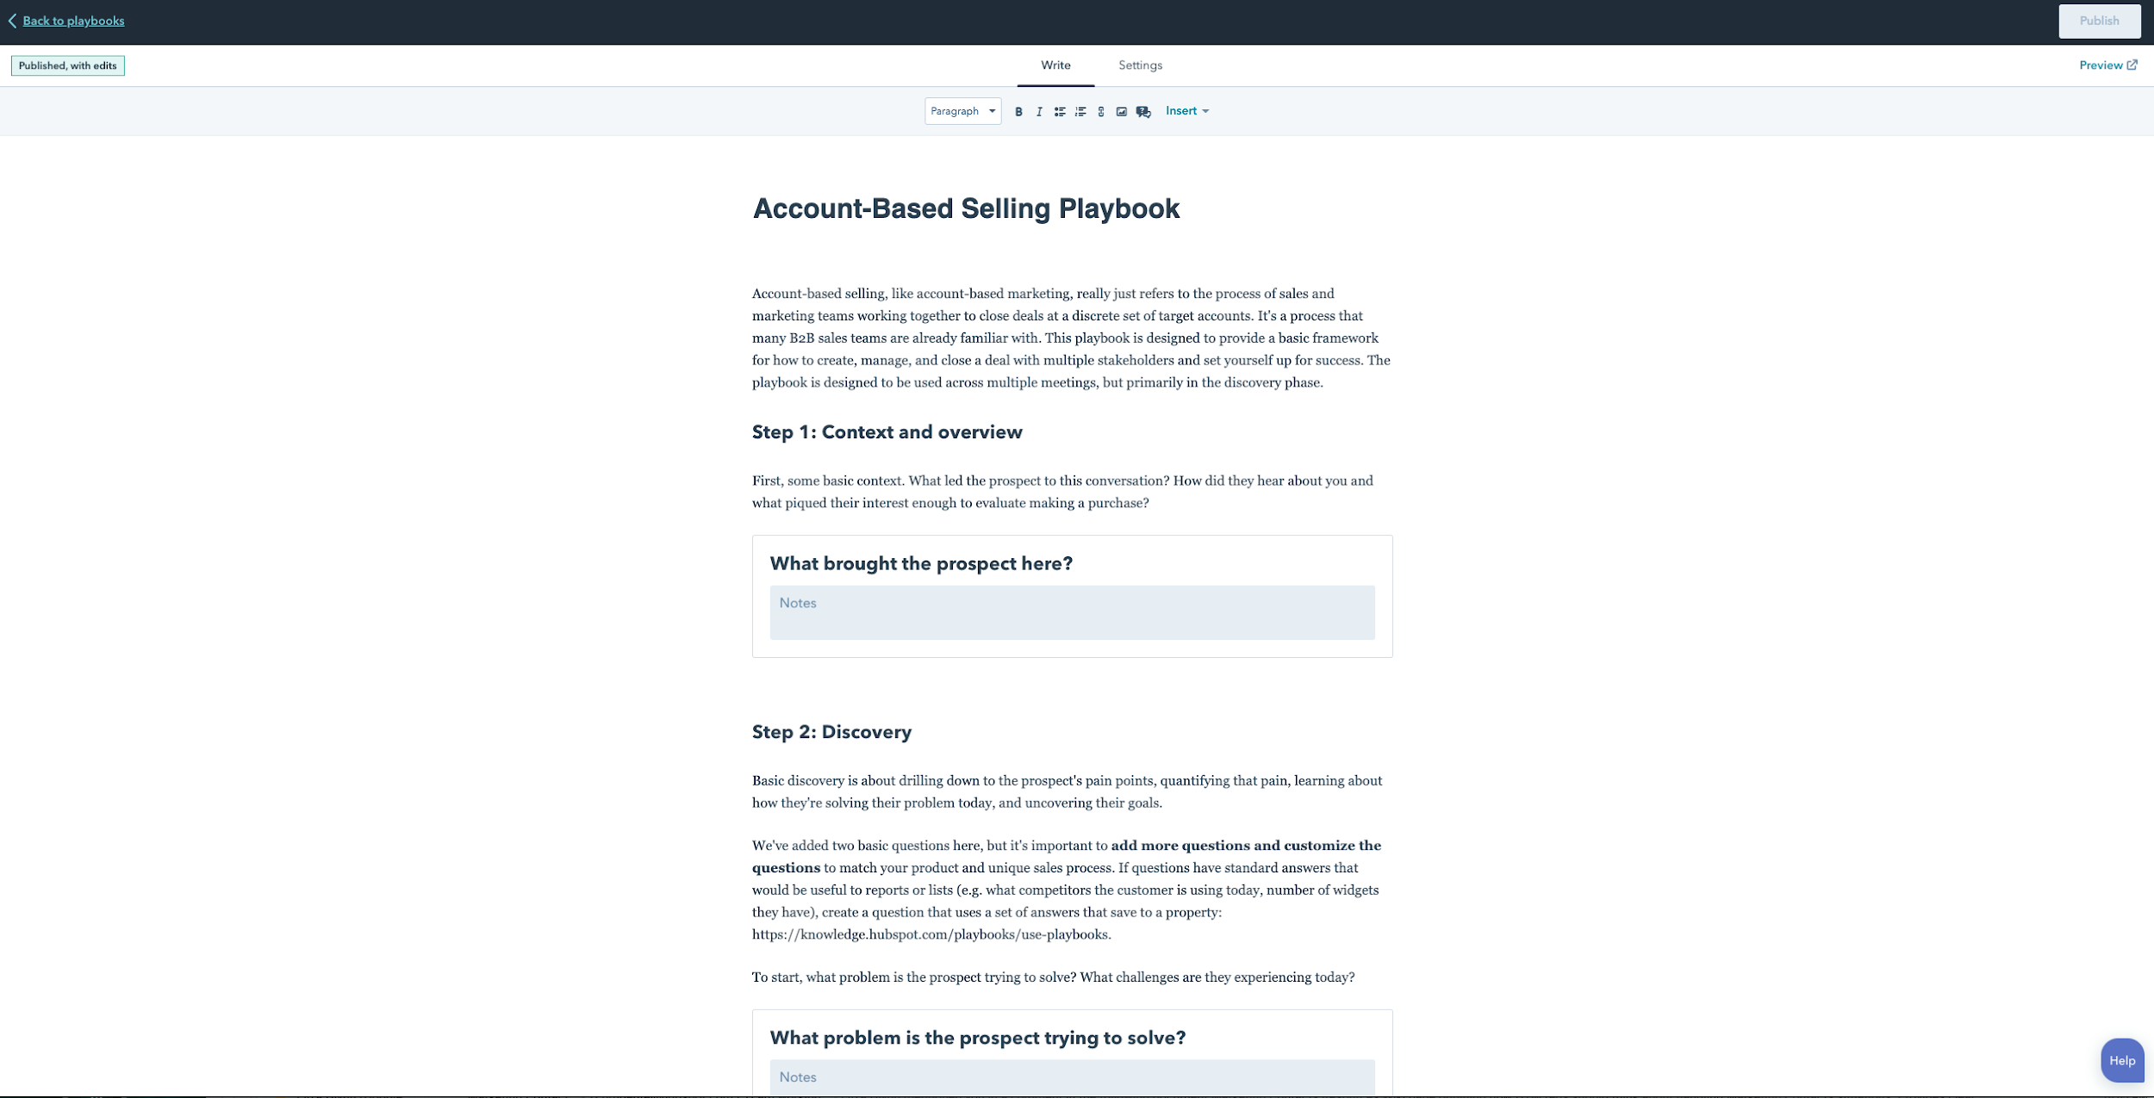
Engage Contacts & Companies
Orchestration

Slide 33
Engage Contacts & Companies
Orchestration
Requires thoughtful set up and application of the following HubSpot tools:
Ads
Automation
Email
Smart Content
Sequences
Tasks
LinkedIn Sales Navigator
Quotes
Meetings
Documents
Deals

Slide 34
HubSpot ValueProp
Notes:
Now that we understand the market a bit more, lets talk about HubSpot’s position

Slide 35
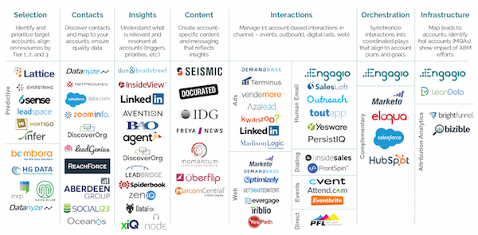
ABM Players
Notes:
When we talk about the ABM market, there are really no “all inclusive” vendors. If you want to accomplish the ideal ABM outcome you will probably need a combination of some (or a bunch) of these tools. Players span a bunch of different categories and introduce a bunch of decision points when building their stack.
This tees us up perfectly to talk about the HubSpot strategy and where we will differentiate

Slide 36
How to execute ABM
Step 1:
Build a Team
Step 2:
Identify Accounts
Step 3:
Create Account Plan
Step 4:
Attract Stakeholders
Step 5:
Forge Relationship
Build a team of at least 1 marketer and 1 salesperson
Identify set list of high value companies to pursue
Align between sales and marketing on goals, content, and channels
Share personalized content across channels
Build and manage relationships with buyers over time
Ongoing: Measure & Iterate
Continually monitor KPIs through entire strategy
Notes:
In addition to the software we also have an ABM methodology. This will help you anchor your conversation around a story and process rather than just featurre dump. This will also look familiar to a hubspot sales rep. Just like we did with inbound we want to be thought leaders in the ABM space. We taught millions to do Inbound and we will do the same with ABM
Building a team is up first because collaboration is our most important theme. No matter how good personalization or reporting tools are, ABM is fundamentally about Sales and Marketing working *together* to create a more sophisticated buying experience. From there you work together to identify accounts, create a plan, attract stakeholders and forge long term relationships. Throughout the entire process, the revenue teams should be measuring and iterating to make things better.
The number one reason customers don’t do ABM is because of a lack of collaboration. Marketing tries to do it in a silo, and no one from Sales will work the accounts. Alternatively, Sales picks target accounts, but the marketing content is general or non-existent for those types of customers.

Slide 37
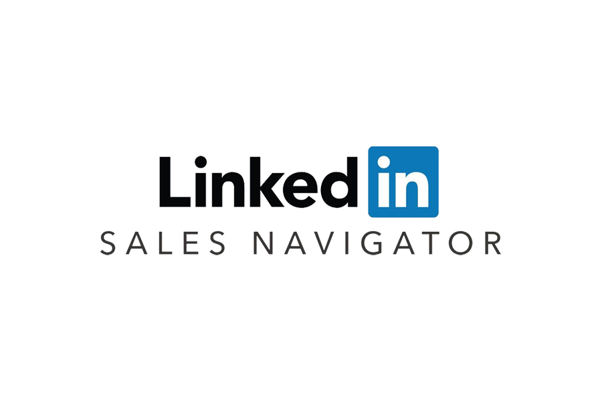
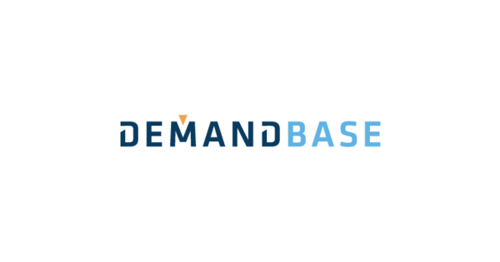
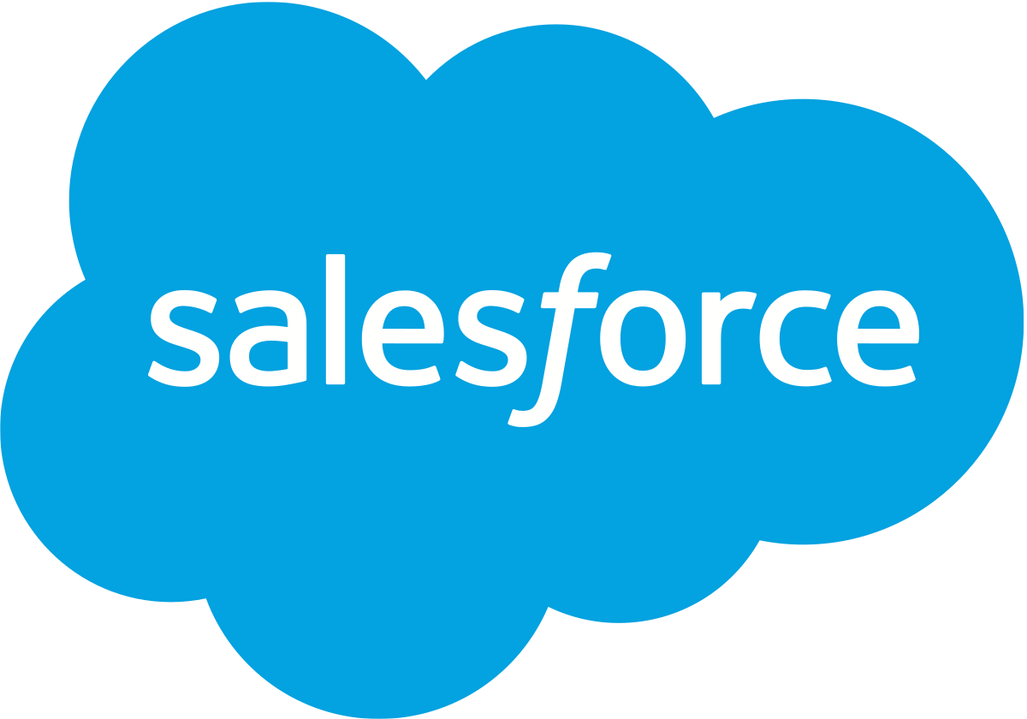
ABM Solutions
Build
Identify
Create
Attract
Engage
Measure
Notes:
Here is a view of that methodology with the legacy way of doing ABM - different vendors for each stage of the journey. Collaboration is our competitors’ biggest gap. No matter how advanced an ABM tool is, it’s almost always siloed in one team or another

Slide 38
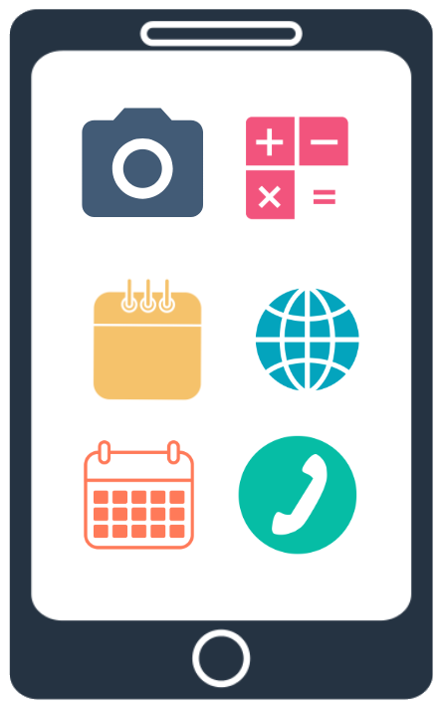
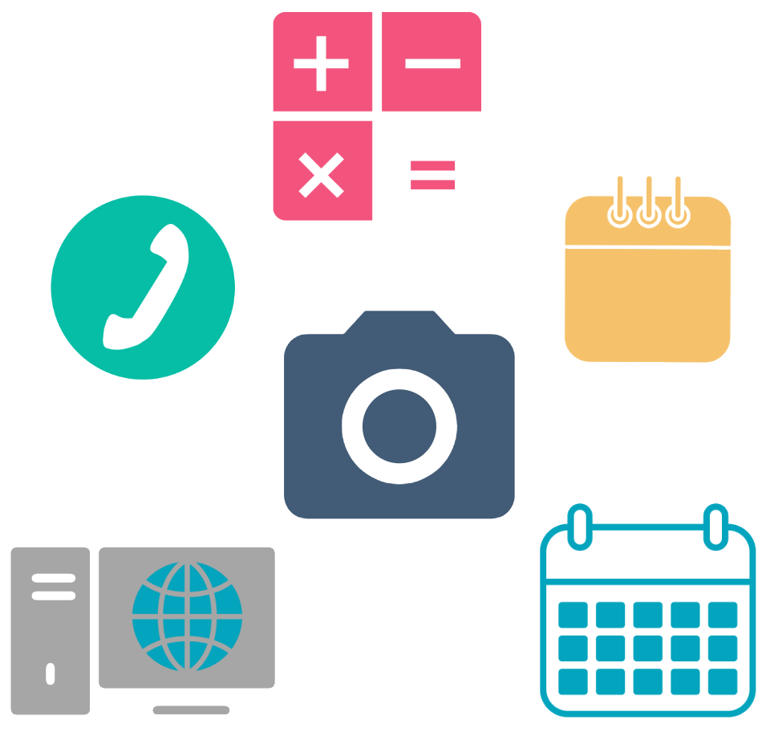
Custom Stack vs. HubSpot
Multiple systems mean multiple points of failure
Opinionated tools conveniently packaged
Difficult to set up and get started
Integrations for specialty tools, only when necessary
Potential data syncing issues
Minimal set up, easy to get started
Sales and Marketing teams in different systems, lack coordination
Sales and Marketing collaboration through single source of truth, closed loop reporting
Notes:
You’ll notice we are using a very similar comparison as we did with CMS Hub and Marketing Hub. When I think about the HubSpot core value prop, this is it: Legacy systems are bloated and stitched together, HubSpot is consolidated and streamlined. The key word here is collaboration.
To run a successful ABM strategy with the other options like SFDC- you need SF, Marketo, Terminus, outreach etc….This leads to a disconnect between the various teams using these tools, an integration problem to keep them all in sync, and a vendor management bottleneck that no business wants to take on. The point of failure ends up being the information flow between systems. Did the action happen? Did it work? What is the next step?
With HubSpot - your revenue team has all of the core tools you need for sales and marketing in one system, packaged in a way that customers WANT.
The reaalmagic is in the orchestration of these efforts - sales and marketing work from a single system of record - this makes it easy to get started, track progress and iterate

Slide 39
ABM in HubSpot
All the tools you need to run a successful ABM strategy across Marketing & Sales.
Build
BUILD YOUR SALES & MARKETING TEAM
Team-friendly Pricing & Packaging
Identify
DEFINE YOUR ICP AND IDENTIFY TARGET ACCOUNTS
Default ABM Properties
ICP Workflow Template
AI-Powered Account Recommendations
Create
CREATE AN ACCOUNT PLAN THAT ALIGNS SALES AND MARKETING
Target Accounts Home
Enhanced Slack Integration
Attract
ATTRACT THE ATTENTION OF KEY STAKEHOLDERS AT TARGET ACCOUNTS
ABM Lists + Ads
App Partner Integrations
Engage
TAILOR YOUR OUTREACH AND ENGAGE KEY STAKEHOLDERS
ABM Playbook Template
Account Overview
Measure
ABM Report Library & Dashboard I Company Scoring
Notes:
HubSpot has the unique position of being able to offer tools to both Sales and Marketing AND we can connect data between them. For example, because HubSpot has access to Marketing and Sales data, we’re able to show Marketing what Sales activities a customer is scheduled to receive (e.g. Tasks, Meetings) and show Sales what marketing activities (emails, ads) a customer is scheduled to receive! Here's the feature we think will drive sales/marketing collaboration.
Additionally, we are putting all of our tools through the ABM prism - on top of adding some features specific to ABM (ICP workflows, ABM playbooks) we’ve also augmented our existing tool set to support sales and marketing accomplishing target account goals. What we are really launching is sales marketing alignment, relative to this methodology.

Slide 40
Marketing Hub Professional & Up
Shared ABM Tools
Sales Hub
Professional & Up
LinkedIn Ads integration enhancement
+
Existing Marketing Hub Features, Including...
Ads
Smart content
Landing pages
Automation
Campaigns
Email
Bots
Account Overview*
+
Existing Sales Hub
Features, Including…
Sequences*
LinkedIn Sales Navigator integration*
Quotes*
HubSpot Video*
Tasks*
eSignature*
Documents
Meetings
Default ABM Properties
Company Lists
Company Scoring
Target Accounts Home
AI-powered Target Account Recommendations
Slack & SalesForce integration enhancements
Out-of-the-box ABM Reports Library & Dashboard
* = Only available with a paid seat in Sales Hub
New ABM features available
Sample of existing features available to support an ABM strategy

Slide 41
ABM in HubSpot Overviews

Slide 42
Marketing Hub Features
New
Ads - Company targeting
Existing
Forms
Smart content
Landing pages
Campaigns
Email
Bots
Automation
Shared (Marketing or Sales Hub)
Company Lists
Company Scoring
Default ABM Properties
Target Accounts Home
AI-powered Target Account Recs
Slack for Account Based Collaboration
ABM in Dashboard Library
Enhanced Salesforce Sync
Notes:
There are some new features, mostly shared between sales and marketing. This graphic may make it seem like we are “only” launching a new ads feature, but the shared features are all things marketers care deeply out

Slide 43
Sales Hub Features
New
Account Overview*
LinkedIn Sales Navigator integration*
Advanced Sequences*
Existing
Sequences*
Documents*
Quotes
HubSpot Video*
Tasks*
Meetings*
Shared (Marketing or Sales Hub)
Company Lists
Company Scoring
Default ABM Properties
Target Accounts Home
AI-powered Target Account Recs
Slack for Account Based Collaboration
ABM in Dashboard Library
Enhanced Salesforce Integration
* Paid Sales Hub seats only
Notes:
On the sales side, there are some key new features that require a paid seat and will help drive sales to companies focused on a complex sales process

Slide 44
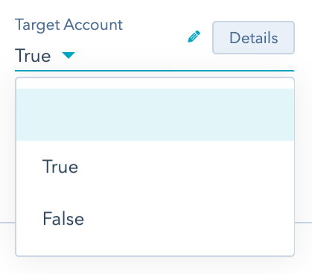
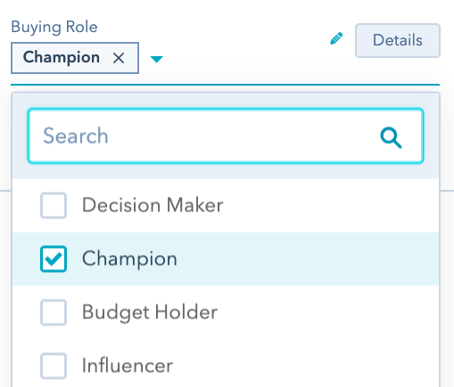
Identify Target Accounts & Stakeholders
Automation and intelligence to help you manage and prioritize target accounts and buyers
Target Account (Company)
Ideal Customer Profile Tier (Company)
Buying Role (Contact Property)
ICP Workflow Template
AI-Powered Account Recommendations
Notes:
These slides will be available to share externally, and cover the features for each theme

Slide 45
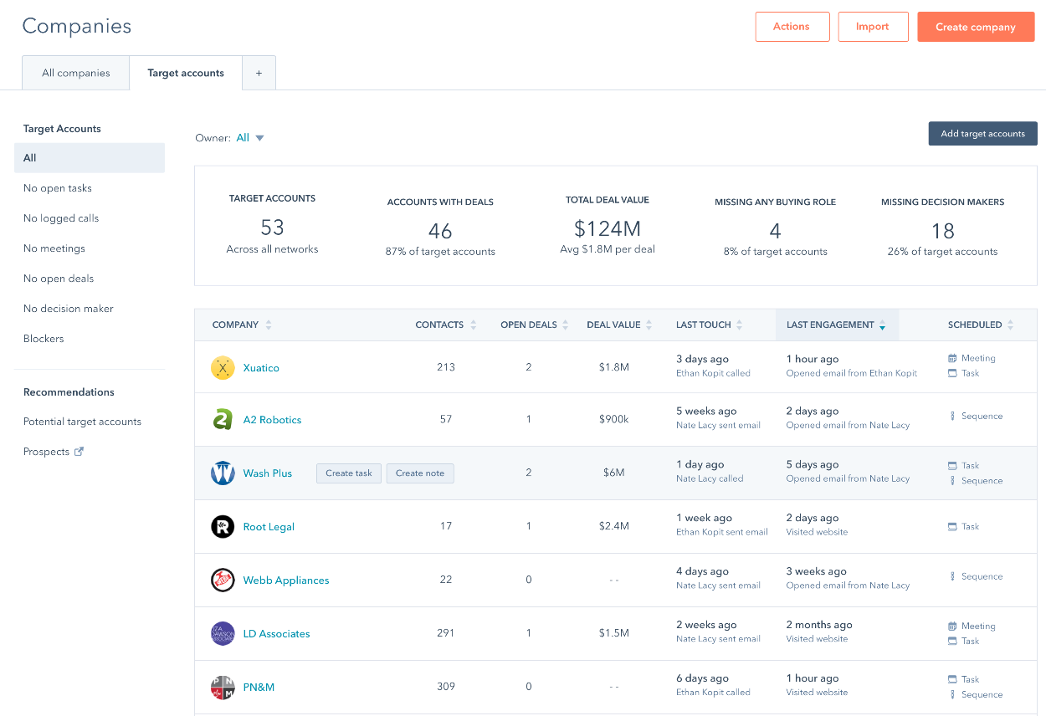
Create an Account Plan
Align Sales and Marketing efforts with collaboration tools
Target Accounts Home
Enhanced Slack Integration
Notes:
A new command center for your Target Account strategy where sales and marketing can come together to review basic funnel metrics, health checks (i.e. all accounts with no buying committee identified), and select new Target Accounts.
HubSpot has had a slack integration with workflows for a while. With the new ABM features, customers are provided additional functionality to Company and Deal workflows. This allows them to:
Create slack channels named after the deal/account
Regularly post important KPIs in slack
Write notes to and from slack to deal/company records in HubSpot.

Slide 46
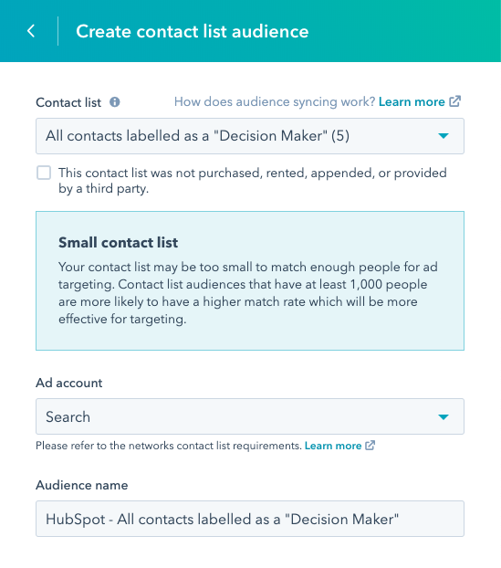
Attract Key Stakeholders
Attract the attention of key stakeholders at target accounts with personalization at scale
ABM Lists + Ads
App Partner Integrations
Notes:
New Ads Functionality and Targeting
A huge aspect of ABM strategy is making sure the right person sees the right content at the right time. Ads play a big part of this strategy and HubSpot is now set up to help an ABM Task Force easily manage their ads. They can do this in a few ways:
Out-of-the-Box Ad Audiences - HubSpot will have ABM-focused lists ready to easily target particular buying roles or other contacts based on their properties.
Company-based Ad Targeting - You’ll be able to target ads to a particular set of companies in the same way you can with contact lists in HubSpot. Customers will have the ability to target lists of companies with certain ABM Properties, such as “Target Account” or “ICP Tier” on LinkedIn.
Smart Content - With the ability to create lists for companies and buying roles, you can create more targeted copy and content.
Page-Specific Chat Bots - Provide a chat experience specific to a company or role on your website.

Slide 47
Engage Key Stakeholders
Account Overview for all company records powering your outreach for maximum engagement
Activity Overview
Contact Overview
Internal Stakeholders Overview
Deal Overview
Site Visits Overview
ABM Playbook Template
Notes:
Activity Overview: A funnel-style activity report showing Marketing and Sales metrics from Sessions → Meetings.
Contact Overview: A rich table of contacts that shows all the contacts at the account with things like Title, Buying Role, Last Touch, Last Engagement, and Scheduled to provide a snapshot of the account.
Internal Stakeholders Overview: A table of everyone from the user’s company who is touching the account (logging calls, meetings, emails, and tasks) ← I think this section is also DOPE
Deal Overview: A table of past and current Deals with the account
Site Visits Overview: A table showing which pages visitors (both known and anonymous) are looking at so reps can personalize their conversations to the account’s interests ← I think this section is also DOPE
Activity Overview: A funnel-style activity report showing Marketing and Sales metrics from Sessions → Meetings.
Contact Overview: A rich table of contacts that shows all the contacts at the account with things like Title, Buying Role, Last Touch, Last Engagement, and Scheduled to provide a snapshot of the account.
Internal Stakeholders Overview: A table of everyone from the user’s company who is touching the account (logging calls, meetings, emails, and tasks) ← I think this section is also DOPE
Deal Overview: A table of past and current Deals with the account
Site Visits Overview: A table showing which pages visitors (both known and anonymous) are looking at so reps can personalize their conversations to the account’s interests ← I think this section is also DOPE

Slide 48
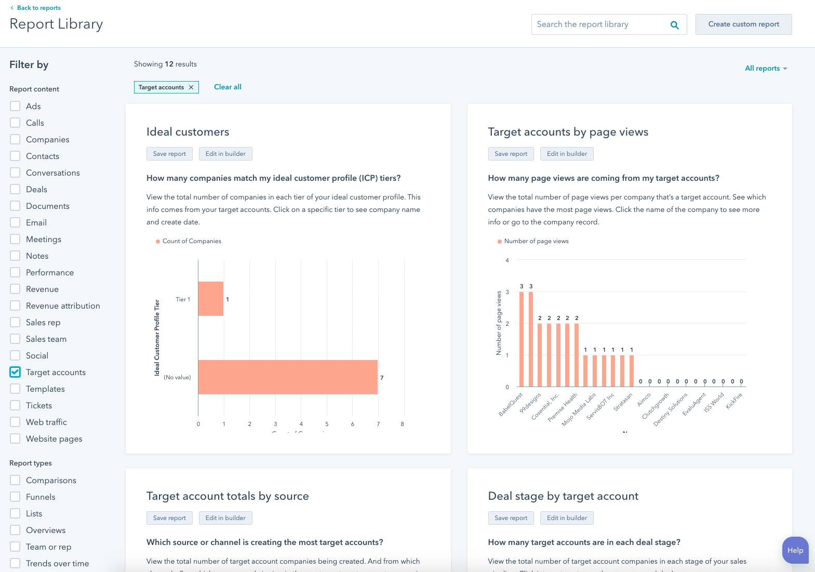
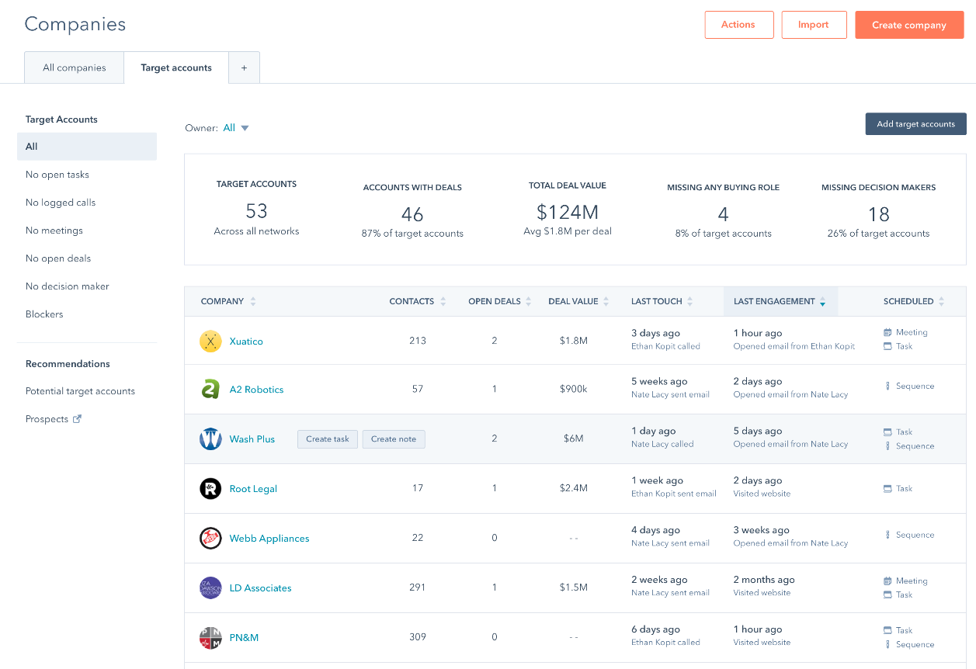
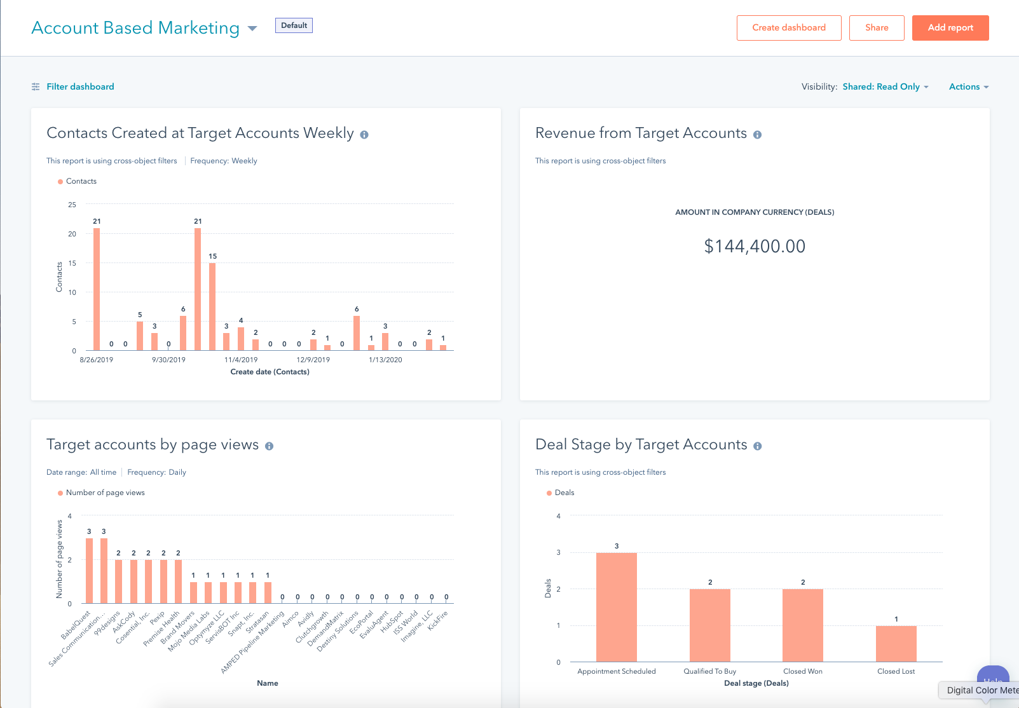
Measure Progress of ABM
Quantify and coordinate your ABM efforts through effective reporting
ABM Dashboard
Target Accounts Dashboard Library
Target Accounts Reports Library
Target Account Recommendations
Target Accounts Home
Account Overview

Slide 49
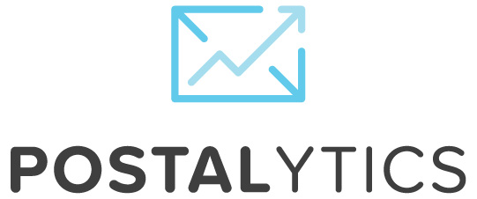
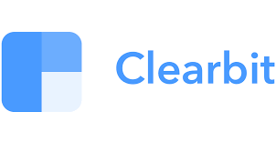
App Partners for Additional Features
ABM Feature Omission | App Partners
Gifting / Direct mail
Advanced ad targeting
Email signatures
Org Chart Visualization
Company and Contact Enrichment
As important as the features we’ve built are the features we’ve chosen not to build. In these areas, we will lean on our rich ecosystem of app and strategic partners to serve our customers’ needs.
Notes:
Account Based Marketing https://ecosystem.hubspot.com/marketplace/apps/marketing/abm
Sales > Account Based Engagement https://ecosystem.hubspot.com/marketplace/apps/sales/sales-enablement?eco_categoryFeatures=ACCOUNT_BASED_ENGAGEMENT

Slide 50
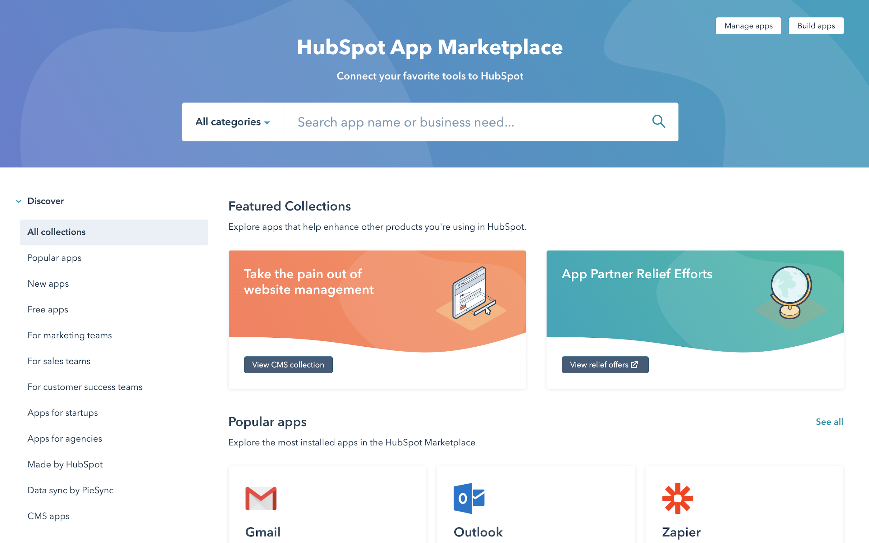
Platform - ecosystem.hubspot.com
ABM Collection will be live May 19 at https://ecosystem.hubspot.com/marketplace/apps/abm
Notes:
New Collection being launched on May 19 called ABM (available on left nav under Collections). URL when live https://ecosystem.hubspot.com/marketplace/apps/abm

Slide 51
Gifting / Direct Mail
Getting traction at target accounts requires relationship building
Gifts like branded swag and bottles of wine or handwritten notes are common tools of relationship selling
Requires a lot of time and effort acquire items, personalize and deliver, if done manually
Send gifts and direct mail at scale through integration and automation

Slide 52
Advanced Ad Targeting
A simple ad campaign might serve up the same message and offer to everyone, regardless of their role or company
Target accounts have a large number of people you could potentially influence but identical messaging misses the mark
By using information in your CRM gathered by Sales or through tracking engagement and integrations, you can segment and personalize your message for maximum impact

Slide 53
Email Signatures
The goal of a Sales email is to gain permission for the next conversation, typically a meeting
The most interested leads will reply or call but many are too early in the buyer’s journey
When used strategically, email signatures can be personalized with content and CTAs giving recipients another way to engage and allow tracking to identify who is interested

Slide 54
Company and Contact Enrichment
Target accounts often have a large number of stakeholders with different buying roles
Accurate and complete company and contact information helps maximize effectiveness of all efforts
Personalize outreach
Shorten web forms to increase landing page conversion
Score and route leads

Slide 55
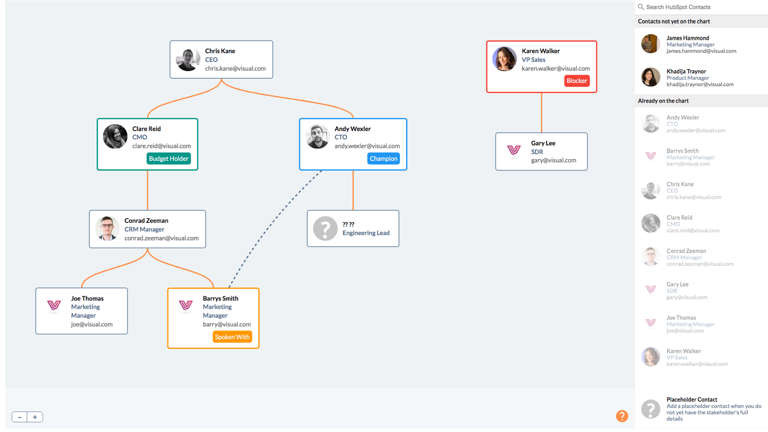
Org Chart Visualization
Target accounts often have a large number of stakeholders with various roles, responsibilities and relationships to others at the same company
Being successful at ABM involves identifying all the stakeholders, their buying roles and how they might influence the deal based on their connections
Visualizing these relationships helps Sales and Marketing refine their ABM strategy for each target account
Notes:
Mention how reps can connect to OrgChartHub for free, request for upgrade to [get process]

Slide 56
Selling Stories
Notes:
Let’s move onto the different narratives you will be integrrating into your sales process depending on the prospect you are talking to

Slide 57
Sales & Marketing ABM Challenges
Sales Reps
Lead Generation/Enrichment
Stakeholder Management
1:1 Outreach
Marketers
Lead Generation
1:Many Outreach
Sales + Marketing
Engage Buyers in a Coordinated Way
Notes:
There are three stories, all centered around stakeholder management
Sales reps are struggling to manage complex sales process with multiple stakeholders
Marketers are struggling to attract companies (vs. just people) with 1:many outreach
Sales and marketing are both trying to engage buyers and struggling to stay aligned
Your pitch will alter based on who you are talking too. Let’s talk about three different flavors of the pitch

Slide 58
Sales Hub Pitch
Problem
Challenge
Solution
Sales reps want to close deals at target accounts (higher value deals) Standard 1:1 outreach fails to engage prospects | Target accounts have buying committees Diverse responsibilities and business perspectives Decentralized decision making | Target Account Overview, Sequences and Templates Orchestrate multiple stakeholders with personalized messaging at scale
Notes:
When pitching to a sales team, the common thread to pull on is lack of engagement with their target accounts. This arises due a wide range of buying roles a the company which makes it hard for reps to break through the noise with a compelling pitch.
With HubSpot, we give you tools that help you map the account and orchestrate your prospecting strategy with personalized messaging. This ensures reps are spending time in the right places, and not spending hours hacking together account plans.

Slide 59
Marketing Hub Pitch
Problem
Challenge
Solution
Marketing tasked with generating and nurturing leads at target accounts Standard methods fail to capture and influence key stakeholders at target accounts | Marketing database has many contacts from a single target account No clear role or responsibility at company Unable to personalize outreach in an engaging way | Company Lists, Company Scoring, Buying Role and Advanced Ad Targeting Segmentation and strategic lead gen efforts
Notes:
For marketers, your entire world is focused on attracting interest from good fit companies so sales will turn them into customers. Most marketers struggle to properly target the right customers becuase they lack insight from sales, and within those accounts have trouble personalizing a 1 to many message to the masses.
HubSpot ABM takes the guesswork out of the equation by aligning sales and marrketing around a target account “command center” and streamlining the personalization efforts to attract more buyers into your world.

Slide 60
Sales + Marketing Hub Pitch
Problem
Challenge
Solution
Marketing defined target accounts aren’t worked by Sales Sales defined target accounts receive generic outreach from Marketing | Marketing unaware of what Sales considers a target account No insight into sales outreach that would help refine who and how to target for outreach | Strong collaboration and closed loop reporting before and after outreach Shared list of target accounts and contacts Personalized messaging developed together
Notes:
When you have a company evaluating both sales and marketing tools with hubspot, the conversation centers totally around collaboration. Traditionally sales and marketing are working in silos leading into lack of insight across the table and a piecemeal strategy to break into accounts. With HubSpot you work from one shared source of truth with single click reporting to ensure everyone is working together towards to the same shared goal.

