Slide 1
Conference call best practices
2021
/// foundations to wow ///

Slide 2
PLANNING
PLAN THE CALL
Key steps for planning a call:
Goal of the call. Examples:
Routine biweekly checkpoint to cover status of many items
Process-driven (SME guidance on strategy for setup, SME presentation of a deliverable, collecting customer feedback or insights to inform a request for production)
Agenda – what are the topics to be discussed?
Attendees – who needs to contribute from TSL? Who needs to join on the client’s end?
Duration – How much time is required for the call to cover and complete the agenda items?
Availability – Check Clarizen resource load and compare with Outlook calendars for internal resources
Create a meeting invitation to book time on attendees’ calendars and secure client’s availability

Slide 3
PREPARATION
PREPARE FOR THE CALL
Key steps for preparing for a call:
Up to 24h prior to the call (no less than 2h prior):
Email the agenda to all attendees, internal and external
If a document or other resource is meant to be reviewed on the call and requires advance review, include in the agenda or as an attachment.
Note that some resources are not meant to be emailed prior to a call, and it is preferred to review live on the call first (website wireframes).
Day of the call:
Plan to give yourself a 5-minute buffer to prepare your tech and have resources for the call ready
If you must join back-to-back calls, kindly alert those running them that you will have a hard stop a few minutes prior to the end of the call so you can lead your next one.

Slide 4
PREP YOUR TECH: VISUALS
General: Do not bookmark and display sites to your work browser that are personal in nature
Each Call: Close internet browser tabs not relevant to the call
Ensure you have one clean screen to share (no desktop files) that is your “call hub”
Close all programs not needed for the call
Move any windows that must remain open to the proper screen “call hub”
General: Open Teams settings and turn off on-screen “Banner” notifications
Each Call:
Close your IM/Chat platform(s) if not being used to run the call
Minimize the chat window if you must leave it open, but know which screen it will appear on if it is maximized on while on the call

Slide 5
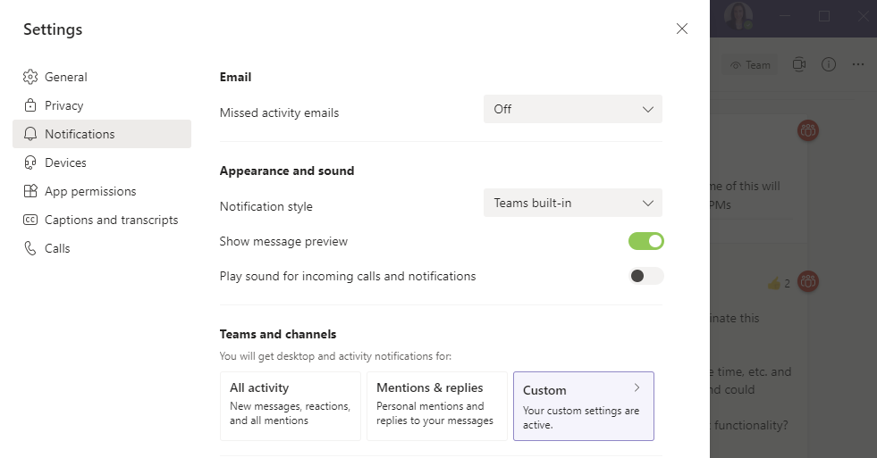
PREP YOUR TECH: TEAMS VISUALS

Slide 6
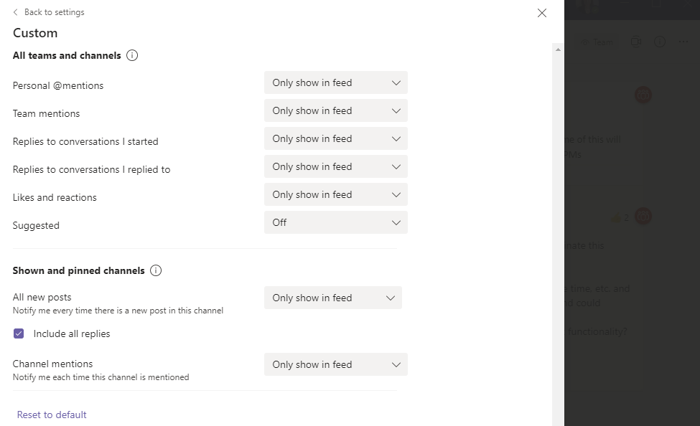
PREP YOUR TECH: TEAMS VISUALS
Notes:
Opt for “Only show in feed” settings. The alternative options include “Banner” which will display alerts on-screen and this is what you want to avoid happening while you are screensharing.

Slide 7
PREP YOUR TECH: TEAMS VISUALS
Notes:
You will need to go back to the Settings panel….

Slide 8
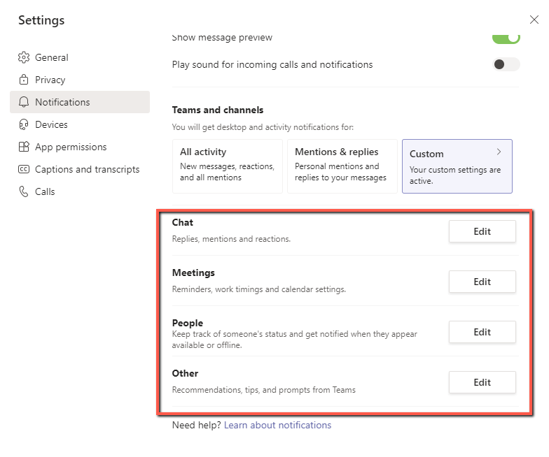
PREP YOUR TECH: TEAMS VISUALS
Notes:
…and scroll down to edit settings on individual options here as well. Again, select “Only show in feed” or “Off” – do not select settings that mention Banner.

Slide 9
PREP YOUR TECH: AUDIO
1x Action: Use a headset or earphones with microphone for higher quality audio. Using laptop microphone increases likelihood of feedback, echo, and ambient noise from your computer.
1x Action: Disable Outlook email send/receive sounds (and display of notifications)
1x Action: Open Teams settings and turn off Sound notifications
Listen for any ambient noises in your work environment and turn off to silence (appliances, fans, background media)
Silence your cell phone

Slide 10
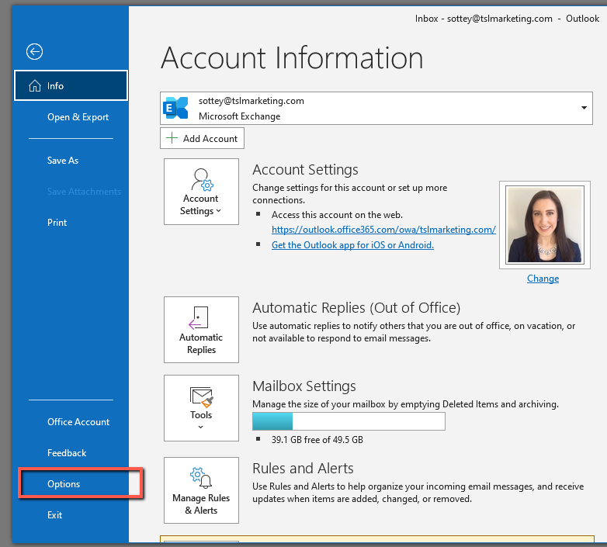
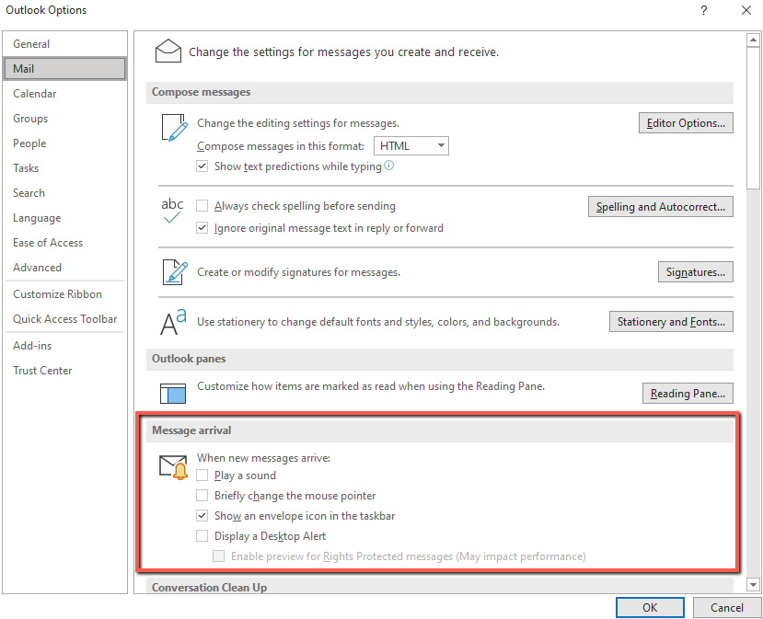
PREP YOUR TECH: AUDIO

Slide 11
PREP YOUR TECH: AUDIO

Slide 12
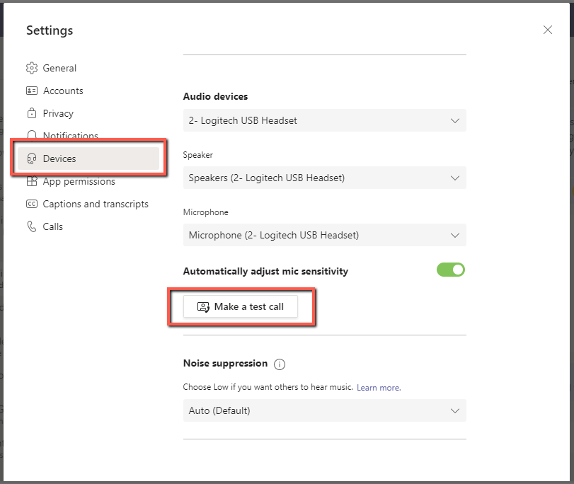
PREP YOUR TECH: AUDIO

Slide 13
LAUNCH THE CALL

Slide 14
LAUNCH THE CALL
BEST PRACTICES
Key steps and considerations for a successful call:
Join the call a minute or two ahead so you are prepared to lead everyone.
Sign into your conference bridge as the meeting host so attendees are not waiting.
Make introductions as needed/if applies for new customers, stakeholders, and TSL attendees.
Review the proposed agenda and ask the customer if there are other topics they’d hoped to discuss if time allows. Make note of when that can be addressed within the agenda.
Tee up topics and pass “speaking role” to TSL attendees and client as relevant to the topics.
Moderate the discussion lightly to ensure there are opportunities to check that the client is following complex topics, and given time to provide feedback.
Take detailed notes on the conversation and aim to be clear on action items/next steps, designated owners, and timing.

