Slide 1
profitability management SYSTEM
2020
/// training ///

Slide 2
profitability MANAGEMENT
Now through December 2020:
Plan projects with more focus on hours, resources, revenue, costs
Use new resource bill rates to plan hours within budget to ensure project plans have sufficient margin
Follow best practices for entering fixed prices on milestones (system reminders, automation copying those values into revenue/cost fields behind the scenes)
CJ-specific:
Open POs for BDTM Commission and send campaign details to Jen to track payout. BDTM bill rates have been decreased to allow us to track this cost separately from hours worked.
Open POs for Data and check that setup hours are logged (system reminders)
Enter Weekly SQLs on hourly campaigns as well as lead guarantee (system reminders)
Monitor for performance tollgate alerts and take action to create improvement plans with SMEs (system reminders)
Manage to planned hours
Next quarter we will:
Give profitability targets for campaigns
Manage to targets

Slide 3
COST MANAGEMENT
Profitability Management is "Cost Management".
The key to ensuring we end up with a profitable project is to PLAN a project with certain level of margin -- then MANAGE to that plan.
Project Management focuses on cost throughout the lifecycle of the project:
Budgeted Cost compared to Expected Revenue (or Budgeted Amount)
Cost we invested to make progress, and how much is left to invest to complete (planned Work vs. Actual Effort)
Actual Cost compared to Actual Revenue earned on the project
Budgeted
Cost
Expected Revenue
IMAGE PLACEHOLDER
(DELETE THIS TEXT BOX)
Actual
Cost
Actual
Revenue

Slide 4
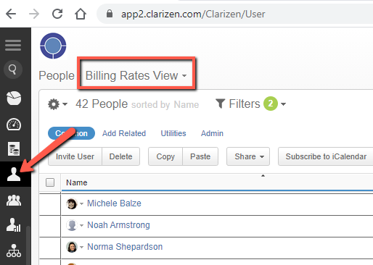
HOURLY RATES
All user and placeholder resources, and CJ project templates, have new hourly Bill and Cost Rates effective 11/1/2020.
The Billing Rate is the fee we charge the customer budget per hour of work
The Cost Rate is the labor cost of the employee’s time for TSL (based on SG&A)
These can be viewed:
In the “People” module in the “Billing Rates View” https://app2.clarizen.com/Clarizen/User
On the project Work Plan using “Prices and Rates” button
On a task where one Resource is assigned Work (Expected Revenue / Work = Resource's Hourly Bill Rate)
We may have a customer agreement for hourly billing rates that differ from our default amounts. The Project Lead must override the Billing Rate for resources on the campaign parent of the project so all work items below inherit the different rates. Process: http://www.screencast.com/t/riPAaZ9K0JEl

Slide 5
Hourly Bill rates
EFFECTIVE 11/1/2020
Copywriter: $175
Designer: $175
Developer: $175
SEO: $175
Proofreader: $175
PMC Responder projects: $105
LPS Hourly projects: $80
Lead Guarantee projects: $80
Consultants David, Brian, Jeff: $250
Ad Manager & Strategy Consultant Ryan N: $250
UX Director Norma: $200
PM – Director: $200
PM - $175
APM - $150
Lead QA by Danielle - $75
Fulfillment or Data logged by Jen - $150
Notes:
Leveled out the digital production rates
Lowered Sr. SME rates to be more reasonable to our project budgets and customer base
Lowered Sr. PM rates
Important to note that we removed the factor of commissions from BDTM services hourly bill and cost rates because we are going to begin opening POs for those costs instead to more accurately attribute them to projects costs

Slide 6
PROJECT PLANNING
PM review SOW and understand types of services we will deliver and costs we will incur, as well as any variation from standard pricing (hourly resource rates or fixed price fees)
If PM fees are not included in SOW, multiply service fees X 15% to define a PM time budget.
Open related Clarizen project and load subproject templates required for all services (Process here)
If undefined budget is in plan, load the correct Revenue Department’s budget placeholder subproject, and edit planned Work hours per instructions on task.
Replace all placeholder resources with known resources (Process here)
Set any contract-defined resource bill rates that differ from our system defaults (Process here)
On CJ projects:
Use “Pricing Sheet and Calculators” excel doc to break out calling budget for labor hours and Commission/Bonus budget with 10% margin
Enter all other required fields in Work Plan and Property Card (CJ Project Details). New additions:
Commission/Bonus Structure and Campaign Level
Maximum SQLs Allowed
Plan Work hours
If Hourly, edit planned Work hours on tasks based on resource bill rates
If Lead Guarantee, edit planned Work hours on tasks based on (Hours Per SQL Maximum field x Weekly SQL Goal)
Enter fees into corresponding milestones' Fixed Price field. For effort-based work, refer to Expected Revenue for fees. For lead-based work, enter Weekly SQL Goals to populate expected revenue, and copy into Fixed Price.
Create Draft Expense Sheets for PO requests. Submit for approval when needed. (Process here)
IMAGE PLACEHOLDER
(DELETE THIS TEXT BOX)
Notes:
Fee entry – There are more rules to prevent entering a fee value into the wrong field or overriding Expected Revenue on accident.
Expense Sheets – A change is that you can create DRAFT expense sheets to plan your POs before Finance Approval. You won't be able to submit them. This is so you can plan costs.

Slide 7
PLAN TOLLGATE
Look at your Work Plan using “Management View”
Is Budgeted Margin % a positive number on all subprojects? On the parent project? (Note: In 2021 a minimum amount will be defined)
YES – go forward
NO to either level
Look at individual subprojects to see which tactics are below margin
Allocate more budget if available from other services
Change resources used
Decrease hours in plan or non-labor costs (click spend, etc.)
If there are issues with budget, asserted rates, and/or goals/expectations - set a meeting with SME and sales lead and:
Come to agreement about which change(s) to implement on the project or opportunities to request more bugdet OR
Get SVP Ops approval to move forward
Post a discussion message to Sarah Ottey that the project is planned and ready to Save as Baseline
Sarah will review project plan for all best practices then Save as Baseline
IMAGE PLACEHOLDER
(DELETE THIS TEXT BOX)
Notes:
Tone of this is that the PM is only held to measure up to the levels that we’re asserting and run through discussion/decision process.

Slide 8
PERFORMANCE ANALYSIS
Use the Management View and manage to the planned Work hours established in your baseline
Baseline Work Variance
A negative number shows you’ve had to ADD Work hours and cost to your plan since you established your baseline plan and allocated budget.
Next step: Add budget to cover the additional hours planned OR
Reduce hours in other requested, draft, or active task areas of your plan where possible to maintain cost levels.
A positive number where time was logged shows time was reduced from original planned Work
Work Variance
A negative number shows the resource logged more Actual Effort than planned Work.
Next step: Add budget to cover the additional hours logged OR
Reduce hours in other requested, draft, or active task areas of your plan where possible to maintain cost levels.
A positive number where time was logged shows efficiency/time saved from original planned Work
Actual Cost
Costs from Labor (time logged) and Non-Labor (expense sheets). This number will appear in red on your work plan if it is higher than the original Budgeted Cost. This relates to Work Variance; adjust plan as noted above.
IMAGE PLACEHOLDER
(DELETE THIS TEXT BOX)

Slide 9
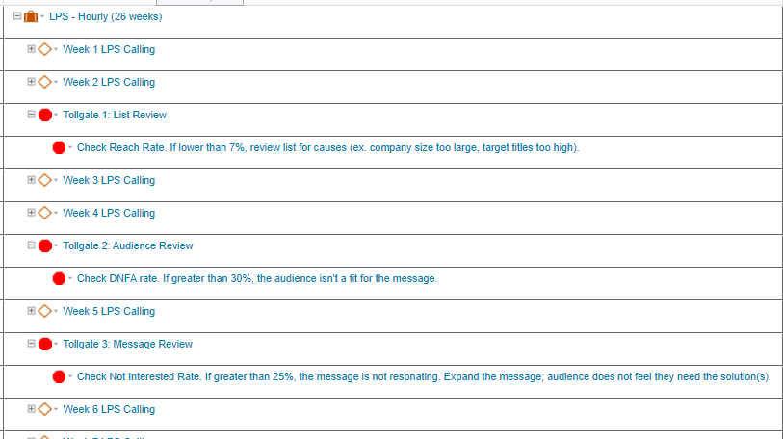
PERFORMANCE ANALYSIS
CJ plan templates include 3 tollgate milestones and tasks with action items.
Evaluate performance metrics and find opportunities to optimize lists, expand campaign parameters where needed to improve profitability.
Mark them complete once resolved (pre-set with $0 Fixed Price, 0 Weekly SQL Goal, 0 Weekly SQLs and won't impact progress calculations).
IMAGE PLACEHOLDER
(DELETE THIS TEXT BOX)

Slide 10
PERFORMANCE ANALYSIS
Automated performance reviews every Tuesday afternoon on lead guarantee campaigns:
Low Delivery: Campaign has 40+ hours Actual Effort but 0 SQLs
Low Efficiency: Campaign has 80+ hours Actual Effort and "Hours Per SQL" is 50+ hours
Low Margin: Hours Per SQL is greater than the Hours Per SQL Maximum upper control limit
IMAGE PLACEHOLDER
(DELETE THIS TEXT BOX)

